Slide 1

Lesson 1: Becoming One in Marriage

Slide 2

Introductions
What is one thing you would like to learn from participating in Anxiously Engaged?

Slide 3
Follow Us:
{"A?":"B","a":5,"d":"B","h":"www.canva.com","c":"DAEgbdBprh8","i":"FnFG1mVckmNm2nHbe8Jk-w","b":1626545686976,"A":[{"A?":"H","A":577.6594676811845,"B":869.7560883241679,"D":158.8290593032107,"C":152.07900524417002,"b":179.66692039007123,"a":172.03128097638478,"c":[{"A?":"I","A":1.4210854715202004e-14,"B":-1.4210854715202004e-14,"D":179.66692039007128,"C":172.03128097638475,"a":{"A":false,"C":"#cced00"}},{"A?":"I","A":35.67732265908816,"B":39.4951423659314,"D":100.67663565820844,"C":100.67663565820844,"N":"illustration","a":{"A":false,"B":{"A":{"A":"MAB0QaOUxuU","B":2},"B":{"D":100.67663565820844,"C":100.67663565820844},"C":{"#010101":"#1b1a1a"}}}}]}],"B":1920,"C":1080}
@anxiously__engaged
Anxiously Engaged
www.AnxiouslyEngaged.byu.edu

Slide 4
Anxiously Engaged Overview
{"A?":"B","a":5,"d":"B","h":"www.canva.com","c":"DAEgbdBprh8","i":"FnFG1mVckmNm2nHbe8Jk-w","b":1626545686976,"A":[{"A?":"H","A":577.6594676811845,"B":869.7560883241679,"D":158.8290593032107,"C":152.07900524417002,"b":179.66692039007123,"a":172.03128097638478,"c":[{"A?":"I","A":1.4210854715202004e-14,"B":-1.4210854715202004e-14,"D":179.66692039007128,"C":172.03128097638475,"a":{"A":false,"C":"#cced00"}},{"A?":"I","A":35.67732265908816,"B":39.4951423659314,"D":100.67663565820844,"C":100.67663565820844,"N":"illustration","a":{"A":false,"B":{"A":{"A":"MAB0QaOUxuU","B":2},"B":{"D":100.67663565820844,"C":100.67663565820844},"C":{"#010101":"#1b1a1a"}}}}]}],"B":1920,"C":1080}
Help couples intentionally prepare for marriage
Help couples work toward becoming one

Slide 5
“Verily I say, men should be anxiously engaged in a good cause, and do many things of their own free will, and bring to pass much righteousness; For the power is in them, wherein they are agents unto themselves. And inasmuch as men do good they shall in nowise lose their reward.”
D&C 58:27-28

Slide 6
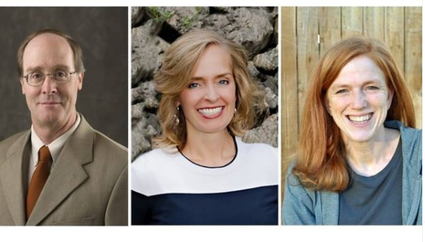
Anxiously Engaged Designers
Dr. Alan Hawkins, Kathryn Pond Sargent, Tamara Gilliland

Slide 7


Faith-based &
Research-based

Slide 8
Intentional Marriage Preparation:
helps avoid some of the disappointing bumps of early-married life
increases the chances of forming healthy, happy marriages
1
2
3
decreases the chances of divorce

Slide 9
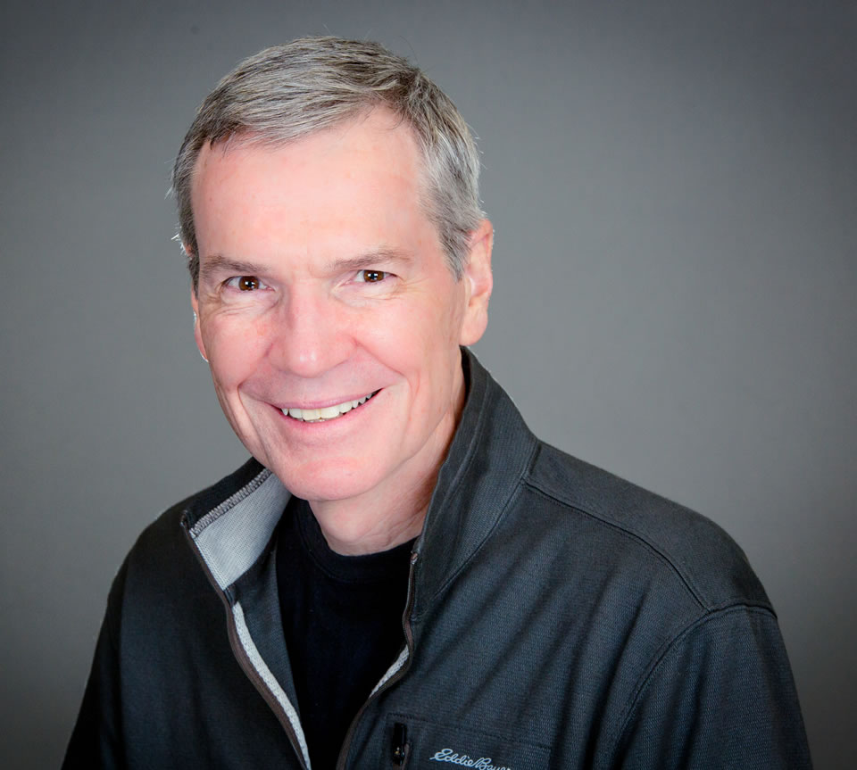
“Decide, don’t slide”
Dr. Scott Stanley
Talking about important decisions now will help reduce confusion, disappointment and conflict.

Slide 10
Anxiously Engaged Format
{"A?":"B","a":5,"d":"B","h":"www.canva.com","c":"DAEgbdBprh8","i":"FnFG1mVckmNm2nHbe8Jk-w","b":1626545686976,"A":[{"A?":"H","A":577.6594676811845,"B":869.7560883241679,"D":158.8290593032107,"C":152.07900524417002,"b":179.66692039007123,"a":172.03128097638478,"c":[{"A?":"I","A":1.4210854715202004e-14,"B":-1.4210854715202004e-14,"D":179.66692039007128,"C":172.03128097638475,"a":{"A":false,"C":"#cced00"}},{"A?":"I","A":35.67732265908816,"B":39.4951423659314,"D":100.67663565820844,"C":100.67663565820844,"N":"illustration","a":{"A":false,"B":{"A":{"A":"MAB0QaOUxuU","B":2},"B":{"D":100.67663565820844,"C":100.67663565820844},"C":{"#010101":"#1b1a1a"}}}}]}],"B":1920,"C":1080}

Slide 11
Class 1:
- Becoming One
- Effective Communication
Class 2:
- Marital Sexuality
Class 3:
- Equal Partnership and
Commitment
- Growing Together
Core Lessons

Slide 12
Utah
Florida
Georgia
Maryland
Minnesota
Oklahoma
South Carolina
Tennessee
Texas
West Virginia
Marriage License Discounts

Slide 13
Becoming One in Marriage
{"A?":"B","a":5,"d":"B","h":"www.canva.com","c":"DAEgbdBprh8","i":"FnFG1mVckmNm2nHbe8Jk-w","b":1626545686976,"A":[{"A?":"H","A":577.6594676811845,"B":869.7560883241679,"D":158.8290593032107,"C":152.07900524417002,"b":179.66692039007123,"a":172.03128097638478,"c":[{"A?":"I","A":1.4210854715202004e-14,"B":-1.4210854715202004e-14,"D":179.66692039007128,"C":172.03128097638475,"a":{"A":false,"C":"#cced00"}},{"A?":"I","A":35.67732265908816,"B":39.4951423659314,"D":100.67663565820844,"C":100.67663565820844,"N":"illustration","a":{"A":false,"B":{"A":{"A":"MAB0QaOUxuU","B":2},"B":{"D":100.67663565820844,"C":100.67663565820844},"C":{"#010101":"#1b1a1a"}}}}]}],"B":1920,"C":1080}

Slide 14
“Happiness in family life is most likely to
be achieved when founded on the teachings of the
Lord Jesus Christ”
-The Family Proclamation

Slide 15
“For this cause shall a man leave his father and mother, and shall cleave to his wife; and they twain shall be one flesh. Wherefore they are no more twain, but one flesh.”
Matthew 19: 3-6

Slide 16
Me → We

Slide 17
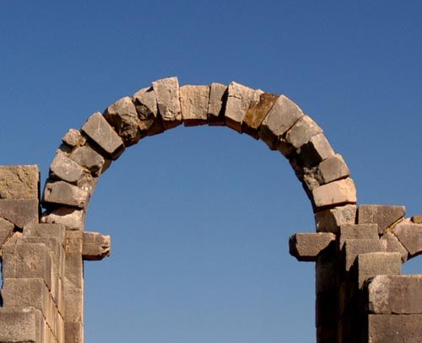

Slide 18



Couple Conversation
Most Like an Arch This Marriage
-John Ciardi
Notes:
https://gohikevirginia.com/hiking-natural-bridge-state-park-va/
Unsplash images

Slide 19
Cleaving and Spousal
Pre-eminence
The Invisible Fence
Prioritizing “We” Over “Me”
3 Principles of Becoming One
Notes:
Image: Light of the World by Scott Sumner

Slide 20
Cleaving & Spousal Pre-eminence
{"A?":"B","a":5,"d":"B","h":"www.canva.com","c":"DAEgbdBprh8","i":"FnFG1mVckmNm2nHbe8Jk-w","b":1626545686976,"A":[{"A?":"H","A":577.6594676811845,"B":869.7560883241679,"D":158.8290593032107,"C":152.07900524417002,"b":179.66692039007123,"a":172.03128097638478,"c":[{"A?":"I","A":1.4210854715202004e-14,"B":-1.4210854715202004e-14,"D":179.66692039007128,"C":172.03128097638475,"a":{"A":false,"C":"#cced00"}},{"A?":"I","A":35.67732265908816,"B":39.4951423659314,"D":100.67663565820844,"C":100.67663565820844,"N":"illustration","a":{"A":false,"B":{"A":{"A":"MAB0QaOUxuU","B":2},"B":{"D":100.67663565820844,"C":100.67663565820844},"C":{"#010101":"#1b1a1a"}}}}]}],"B":1920,"C":1080}

Slide 21
Cleaving and Spousal Pre-eminence
“Thou shalt love thy wife with all thy heart, and shalt cleave unto her and none else.”
D&C 42:22
Notes:
Image: Light of the World by Scott Sumner

Slide 22
“The words none else eliminate everyone and everything. The spouse then becomes pre-eminent in the life of the husband or wife and neither social life nor occupational life nor political life nor any other interest nor person nor thing shall ever take precedence over the companion spouse.”
- Spencer W. Kimball

Slide 23
  Couples must be intentional in putting their marriage first

Slide 24
The Invisible Fence
{"A?":"B","a":5,"d":"B","h":"www.canva.com","c":"DAEgbdBprh8","i":"FnFG1mVckmNm2nHbe8Jk-w","b":1626545686976,"A":[{"A?":"H","A":577.6594676811845,"B":869.7560883241679,"D":158.8290593032107,"C":152.07900524417002,"b":179.66692039007123,"a":172.03128097638478,"c":[{"A?":"I","A":1.4210854715202004e-14,"B":-1.4210854715202004e-14,"D":179.66692039007128,"C":172.03128097638475,"a":{"A":false,"C":"#cced00"}},{"A?":"I","A":35.67732265908816,"B":39.4951423659314,"D":100.67663565820844,"C":100.67663565820844,"N":"illustration","a":{"A":false,"B":{"A":{"A":"MAB0QaOUxuU","B":2},"B":{"D":100.67663565820844,"C":100.67663565820844},"C":{"#010101":"#1b1a1a"}}}}]}],"B":1920,"C":1080}

Slide 25
A boundary to protect the sacred and intimate parts of our relationship

Slide 26
“When you are married, be fiercely loyal one to another.”
-President Gordon B. Hinckley

Slide 27

Group Discussion
  What do we do that really shows our loyalty – our cleaving – to our spouse?
  And what do we do – often unknowingly or unintentionally – that shows a lack of cleaving or loyalty?

Slide 28
Prioritize We or Me
{"A?":"B","a":5,"d":"B","h":"www.canva.com","c":"DAEgbdBprh8","i":"FnFG1mVckmNm2nHbe8Jk-w","b":1626545686976,"A":[{"A?":"H","A":577.6594676811845,"B":869.7560883241679,"D":158.8290593032107,"C":152.07900524417002,"b":179.66692039007123,"a":172.03128097638478,"c":[{"A?":"I","A":1.4210854715202004e-14,"B":-1.4210854715202004e-14,"D":179.66692039007128,"C":172.03128097638475,"a":{"A":false,"C":"#cced00"}},{"A?":"I","A":35.67732265908816,"B":39.4951423659314,"D":100.67663565820844,"C":100.67663565820844,"N":"illustration","a":{"A":false,"B":{"A":{"A":"MAB0QaOUxuU","B":2},"B":{"D":100.67663565820844,"C":100.67663565820844},"C":{"#010101":"#1b1a1a"}}}}]}],"B":1920,"C":1080}

Slide 29
Prioritizing
“We over Me”
“Each party must eliminate the ‘I’ and the ‘my’ and substitute therefore ‘we’ and ‘our’”
-President Spencer W. Kimball

Slide 30
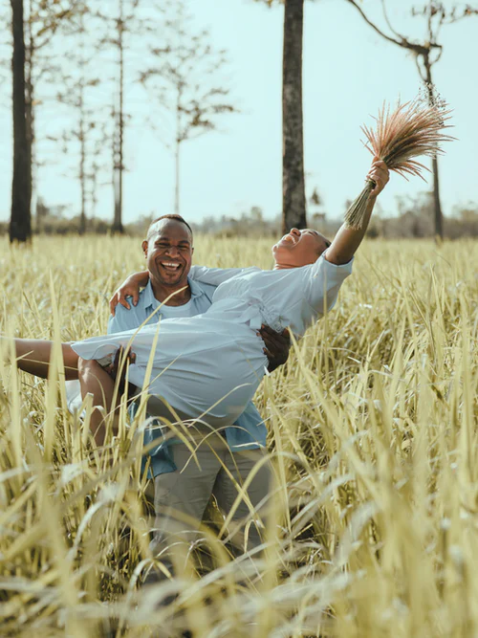
Couple Conversation
We over Me
Notes:
https://gohikevirginia.com/hiking-natural-bridge-state-park-va/

Slide 31
Conclusion
{"A?":"B","a":5,"d":"B","h":"www.canva.com","c":"DAEgbdBprh8","i":"FnFG1mVckmNm2nHbe8Jk-w","b":1626545686976,"A":[{"A?":"H","A":577.6594676811845,"B":869.7560883241679,"D":158.8290593032107,"C":152.07900524417002,"b":179.66692039007123,"a":172.03128097638478,"c":[{"A?":"I","A":1.4210854715202004e-14,"B":-1.4210854715202004e-14,"D":179.66692039007128,"C":172.03128097638475,"a":{"A":false,"C":"#cced00"}},{"A?":"I","A":35.67732265908816,"B":39.4951423659314,"D":100.67663565820844,"C":100.67663565820844,"N":"illustration","a":{"A":false,"B":{"A":{"A":"MAB0QaOUxuU","B":2},"B":{"D":100.67663565820844,"C":100.67663565820844},"C":{"#010101":"#1b1a1a"}}}}]}],"B":1920,"C":1080}
“Happiness in marriage…can exceed a thousand times any other happiness.”
- Elder James E. Faust

Slide 32

Break Time!

