Slide 1

Lesson 4: Becoming One Through Equal Partnership
& Complete Commitment

Slide 2
  Developing an equal partnership
  Committing completely
  Growing together
Today

Slide 3
Developing an Equal Partnership
{"A?":"B","a":5,"d":"B","h":"www.canva.com","c":"DAEgbdBprh8","i":"FnFG1mVckmNm2nHbe8Jk-w","b":1626545686976,"A":[{"A?":"H","A":577.6594676811845,"B":869.7560883241679,"D":158.8290593032107,"C":152.07900524417002,"b":179.66692039007123,"a":172.03128097638478,"c":[{"A?":"I","A":1.4210854715202004e-14,"B":-1.4210854715202004e-14,"D":179.66692039007128,"C":172.03128097638475,"a":{"A":false,"C":"#cced00"}},{"A?":"I","A":35.67732265908816,"B":39.4951423659314,"D":100.67663565820844,"C":100.67663565820844,"N":"illustration","a":{"A":false,"B":{"A":{"A":"MAB0QaOUxuU","B":2},"B":{"D":100.67663565820844,"C":100.67663565820844},"C":{"#010101":"#1b1a1a"}}}}]}],"B":1920,"C":1080}

Slide 4
“In the marriage companionship there is neither inferiority nor superiority. The woman does not walk ahead of the man; neither does the man walk ahead of the woman. They walk side by side as a son and daughter of God on an eternal journey.”
- President Gordon B. Hinckley

Slide 5
  Happier relationships
  Greater marital satisfaction
  More sexual satisfaction
  Better individual well-being
  Less depression
  More effective co-parenting
  Better functioning children
  Less verbal aggression and physical violence
Benefits of
Equal Partnership

Slide 6
Cultural & Doctrinal Misunderstandings
{"A?":"B","a":5,"d":"B","h":"www.canva.com","c":"DAEgbdBprh8","i":"FnFG1mVckmNm2nHbe8Jk-w","b":1626545686976,"A":[{"A?":"H","A":577.6594676811845,"B":869.7560883241679,"D":158.8290593032107,"C":152.07900524417002,"b":179.66692039007123,"a":172.03128097638478,"c":[{"A?":"I","A":1.4210854715202004e-14,"B":-1.4210854715202004e-14,"D":179.66692039007128,"C":172.03128097638475,"a":{"A":false,"C":"#cced00"}},{"A?":"I","A":35.67732265908816,"B":39.4951423659314,"D":100.67663565820844,"C":100.67663565820844,"N":"illustration","a":{"A":false,"B":{"A":{"A":"MAB0QaOUxuU","B":2},"B":{"D":100.67663565820844,"C":100.67663565820844},"C":{"#010101":"#1b1a1a"}}}}]}],"B":1920,"C":1080}
Notes:
ASK: Can you think of some general cultural traditions (current and historical) that don’t view women as equal?
ASK: Can you think of any of the teachings of our faith that have sometimes been misunderstood to see women as less than equal?

Slide 7

Core Teachings
  We have a Mother in Heaven
  We celebrate Eve and her choice
  The government of heaven is family governance

Slide 8
Decision Making
{"A?":"B","a":5,"d":"B","h":"www.canva.com","c":"DAEgbdBprh8","i":"FnFG1mVckmNm2nHbe8Jk-w","b":1626545686976,"A":[{"A?":"H","A":577.6594676811845,"B":869.7560883241679,"D":158.8290593032107,"C":152.07900524417002,"b":179.66692039007123,"a":172.03128097638478,"c":[{"A?":"I","A":1.4210854715202004e-14,"B":-1.4210854715202004e-14,"D":179.66692039007128,"C":172.03128097638475,"a":{"A":false,"C":"#cced00"}},{"A?":"I","A":35.67732265908816,"B":39.4951423659314,"D":100.67663565820844,"C":100.67663565820844,"N":"illustration","a":{"A":false,"B":{"A":{"A":"MAB0QaOUxuU","B":2},"B":{"D":100.67663565820844,"C":100.67663565820844},"C":{"#010101":"#1b1a1a"}}}}]}],"B":1920,"C":1080}

Slide 9
“When a man and woman are sealed in the temple…together they obtain and receive priesthood blessings and power to direct the affairs of their family…They have equal power to receive revelation for their family. When they work together in love and righteousness, their decisions are heaven blessed.”
- Elder Quentin L. Cook

Slide 10
“In the Church there is a distinct line of authority. We serve where called by those who preside over us. In the home it is a partnership with husband and wife equally yoked together, sharing in decisions, always working together.”
- Elder Boyd K. Packer
Notes:
ASK: How does understanding this change your perspective on marital decision making?

Slide 11

Couple Conversation
Equal Partnership
Notes:
[Play soft music during this time]

Slide 12
Committing Completely
{"A?":"B","a":5,"d":"B","h":"www.canva.com","c":"DAEgbdBprh8","i":"FnFG1mVckmNm2nHbe8Jk-w","b":1626545686976,"A":[{"A?":"H","A":577.6594676811845,"B":869.7560883241679,"D":158.8290593032107,"C":152.07900524417002,"b":179.66692039007123,"a":172.03128097638478,"c":[{"A?":"I","A":1.4210854715202004e-14,"B":-1.4210854715202004e-14,"D":179.66692039007128,"C":172.03128097638475,"a":{"A":false,"C":"#cced00"}},{"A?":"I","A":35.67732265908816,"B":39.4951423659314,"D":100.67663565820844,"C":100.67663565820844,"N":"illustration","a":{"A":false,"B":{"A":{"A":"MAB0QaOUxuU","B":2},"B":{"D":100.67663565820844,"C":100.67663565820844},"C":{"#010101":"#1b1a1a"}}}}]}],"B":1920,"C":1080}

Slide 13
“Marriage is the sort of thing where it’s safer to go all in, and it’s dangerous to go in half-hearted. At the far end, when done well, you see people enjoying the deepest steady joy you can find on this earth.”
- David Brooks
Notes:
ASK: What could be dangerous about going into marriage “half-hearted?”

Slide 14
Divorce Research
{"A?":"B","a":5,"d":"B","h":"www.canva.com","c":"DAEgbdBprh8","i":"FnFG1mVckmNm2nHbe8Jk-w","b":1626545686976,"A":[{"A?":"H","A":577.6594676811845,"B":869.7560883241679,"D":158.8290593032107,"C":152.07900524417002,"b":179.66692039007123,"a":172.03128097638478,"c":[{"A?":"I","A":1.4210854715202004e-14,"B":-1.4210854715202004e-14,"D":179.66692039007128,"C":172.03128097638475,"a":{"A":false,"C":"#cced00"}},{"A?":"I","A":35.67732265908816,"B":39.4951423659314,"D":100.67663565820844,"C":100.67663565820844,"N":"illustration","a":{"A":false,"B":{"A":{"A":"MAB0QaOUxuU","B":2},"B":{"D":100.67663565820844,"C":100.67663565820844},"C":{"#010101":"#1b1a1a"}}}}]}],"B":1920,"C":1080}

Slide 15
“What God hath joined together, let not man put asunder.”
Matthew 19:6

Slide 16
The #1 reason for divorce:
lack of commitment

Slide 17
Divorce Statistics
  In the US
    40% of first marriages
    60% of second marriages
    end in divorce

Slide 18
Church Teachings on Divorce
{"A?":"B","a":5,"d":"B","h":"www.canva.com","c":"DAEgbdBprh8","i":"FnFG1mVckmNm2nHbe8Jk-w","b":1626545686976,"A":[{"A?":"H","A":577.6594676811845,"B":869.7560883241679,"D":158.8290593032107,"C":152.07900524417002,"b":179.66692039007123,"a":172.03128097638478,"c":[{"A?":"I","A":1.4210854715202004e-14,"B":-1.4210854715202004e-14,"D":179.66692039007128,"C":172.03128097638475,"a":{"A":false,"C":"#cced00"}},{"A?":"I","A":35.67732265908816,"B":39.4951423659314,"D":100.67663565820844,"C":100.67663565820844,"N":"illustration","a":{"A":false,"B":{"A":{"A":"MAB0QaOUxuU","B":2},"B":{"D":100.67663565820844,"C":100.67663565820844},"C":{"#010101":"#1b1a1a"}}}}]}],"B":1920,"C":1080}

Slide 19
“What, then, might be ‘just cause’ for breaking the covenants of marriage? Over a lifetime of dealing with human problems, I have struggled to understand what might be considered ‘just cause’ for breaking of covenants. I confess I do not claim the wisdom nor authority to definitively state what is ‘just cause.’ Only the parties to the marriage can determine this. . . . In my opinion, ‘just cause’ should be nothing less serious than a prolonged and apparently irredeemable relationship which is destructive of a person’s dignity as a human being.”
- President James E. Faust

Slide 20

3 Wise Tests
Length of marital difficulties
“Apparently irredeemable” relationship
Destructive of our dignity as a child of God

Slide 21

Couple Conversation
Divorce Philosophy
Notes:
[Play soft music during this time]

Slide 22
Conclusion
{"A?":"B","a":5,"d":"B","h":"www.canva.com","c":"DAEgbdBprh8","i":"FnFG1mVckmNm2nHbe8Jk-w","b":1626545686976,"A":[{"A?":"H","A":577.6594676811845,"B":869.7560883241679,"D":158.8290593032107,"C":152.07900524417002,"b":179.66692039007123,"a":172.03128097638478,"c":[{"A?":"I","A":1.4210854715202004e-14,"B":-1.4210854715202004e-14,"D":179.66692039007128,"C":172.03128097638475,"a":{"A":false,"C":"#cced00"}},{"A?":"I","A":35.67732265908816,"B":39.4951423659314,"D":100.67663565820844,"C":100.67663565820844,"N":"illustration","a":{"A":false,"B":{"A":{"A":"MAB0QaOUxuU","B":2},"B":{"D":100.67663565820844,"C":100.67663565820844},"C":{"#010101":"#1b1a1a"}}}}]}],"B":1920,"C":1080}

Slide 23
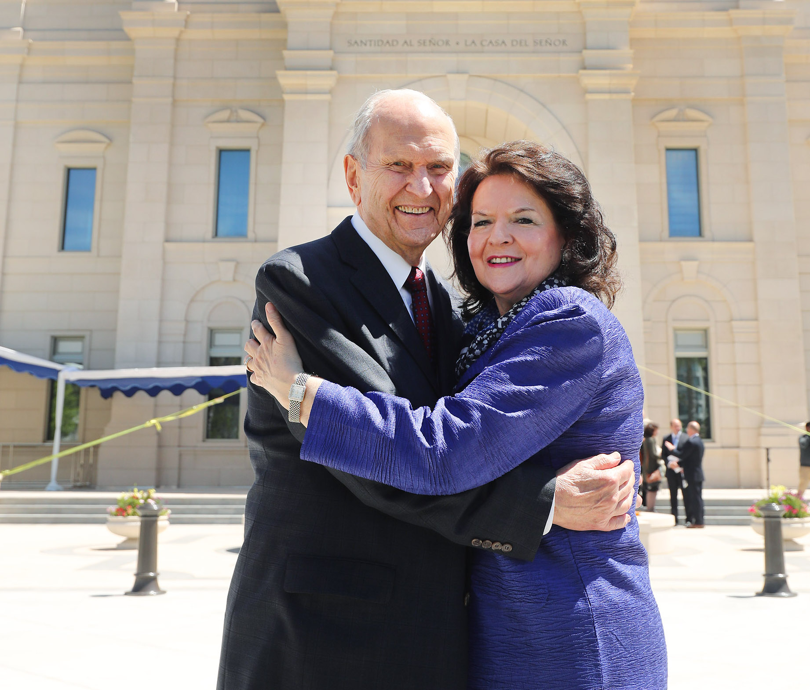
“Marriage brings greater possibilities for happiness than does any other human relationship.”
- President Russell M. Nelson

Slide 24

Break Time!

