Slide 1

Lesson 5: Becoming One Through Growing Together

Slide 2
What is entropy?

Slide 3
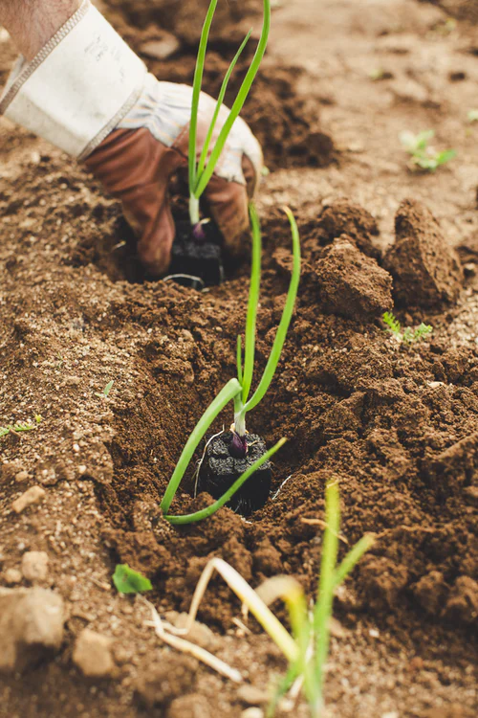
Intentionally
Nurturing our Marriage
Investing
Learning
Serving

Slide 4
Investing
{"A?":"B","a":5,"d":"B","h":"www.canva.com","c":"DAEgbdBprh8","i":"FnFG1mVckmNm2nHbe8Jk-w","b":1626545686976,"A":[{"A?":"H","A":577.6594676811845,"B":869.7560883241679,"D":158.8290593032107,"C":152.07900524417002,"b":179.66692039007123,"a":172.03128097638478,"c":[{"A?":"I","A":1.4210854715202004e-14,"B":-1.4210854715202004e-14,"D":179.66692039007128,"C":172.03128097638475,"a":{"A":false,"C":"#cced00"}},{"A?":"I","A":35.67732265908816,"B":39.4951423659314,"D":100.67663565820844,"C":100.67663565820844,"N":"illustration","a":{"A":false,"B":{"A":{"A":"MAB0QaOUxuU","B":2},"B":{"D":100.67663565820844,"C":100.67663565820844},"C":{"#010101":"#1b1a1a"}}}}]}],"B":1920,"C":1080}

Slide 5
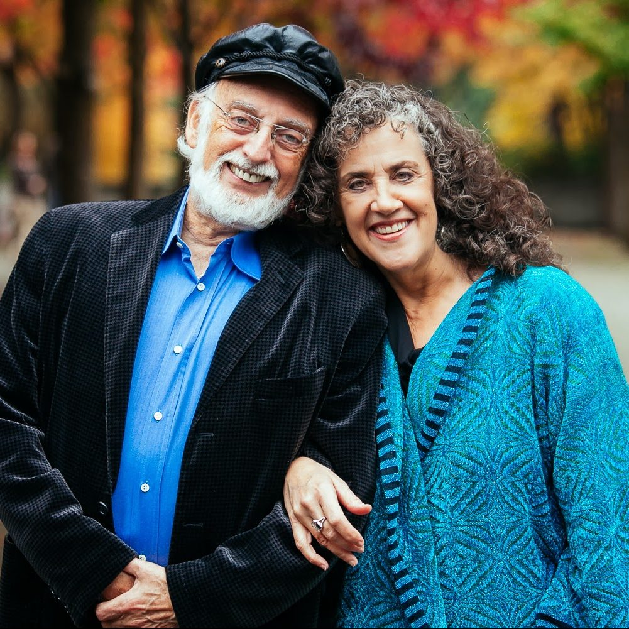
The Magic 6 Hours
Dr. John Gottman

Slide 6
Gottman’s Magic Six Hours:
1. Partings | 2 min/day = 10 min/week
2. Reunions | 20 min/day = 1 hr 40 min/week
3. Admiration and Appreciation | 5 min/day = 35 min/week
4. Affection | 5 min/day = 35 min/week
5. Weekly Date | 2 hr/week
6. State of the Union Meeting | 1 hr/week
Notes:
See gottman.com

Slide 7

Couple Conversation
Magic 6 Hours
Notes:
[Play soft music during this time]
ASK: Does anyone have any thoughts on the Magic 6 Hours they want to share?

Slide 8
Learning
{"A?":"B","a":5,"d":"B","h":"www.canva.com","c":"DAEgbdBprh8","i":"FnFG1mVckmNm2nHbe8Jk-w","b":1626545686976,"A":[{"A?":"H","A":577.6594676811845,"B":869.7560883241679,"D":158.8290593032107,"C":152.07900524417002,"b":179.66692039007123,"a":172.03128097638478,"c":[{"A?":"I","A":1.4210854715202004e-14,"B":-1.4210854715202004e-14,"D":179.66692039007128,"C":172.03128097638475,"a":{"A":false,"C":"#cced00"}},{"A?":"I","A":35.67732265908816,"B":39.4951423659314,"D":100.67663565820844,"C":100.67663565820844,"N":"illustration","a":{"A":false,"B":{"A":{"A":"MAB0QaOUxuU","B":2},"B":{"D":100.67663565820844,"C":100.67663565820844},"C":{"#010101":"#1b1a1a"}}}}]}],"B":1920,"C":1080}

Slide 9
When properly done, seeking help from others does not break the loyalty you have built.

Slide 10
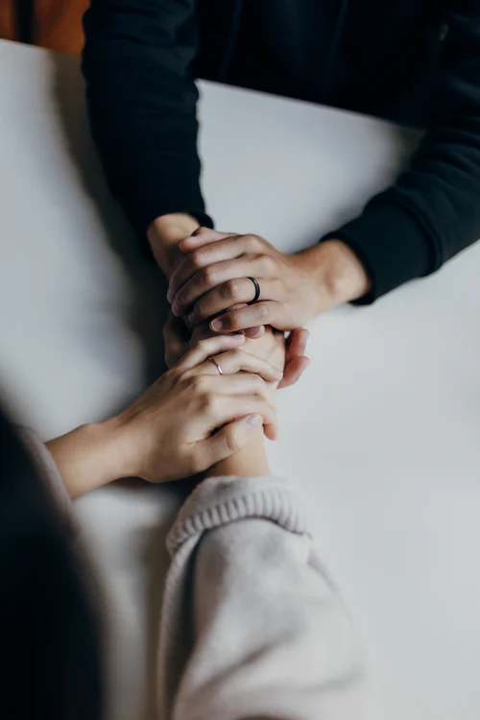
Group Discussion
What are some good ways we can reach out together for support?
What are principles that can guide how we do this?

Slide 11

Seeking Outside Help
Marital Support System
Other Resources

Slide 12
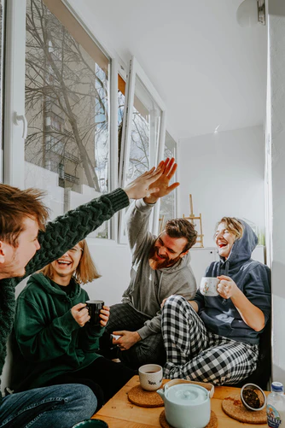

Marital Support
System
Notes:
www.freepik.com

Slide 13

Other
Resources
Notes:
www.freepik.com

Slide 14

Resources
{"A?":"B","a":5,"d":"B","h":"www.canva.com","c":"DAEgbdBprh8","i":"FnFG1mVckmNm2nHbe8Jk-w","b":1626545686976,"A":[{"A?":"H","A":577.6594676811845,"B":869.7560883241679,"D":158.8290593032107,"C":152.07900524417002,"b":179.66692039007123,"a":172.03128097638478,"c":[{"A?":"I","A":1.4210854715202004e-14,"B":-1.4210854715202004e-14,"D":179.66692039007128,"C":172.03128097638475,"a":{"A":false,"C":"#cced00"}},{"A?":"I","A":35.67732265908816,"B":39.4951423659314,"D":100.67663565820844,"C":100.67663565820844,"N":"illustration","a":{"A":false,"B":{"A":{"A":"MAB0QaOUxuU","B":2},"B":{"D":100.67663565820844,"C":100.67663565820844},"C":{"#010101":"#1b1a1a"}}}}]}],"B":1920,"C":1080}
Notes:
www.freepik.com

Slide 15
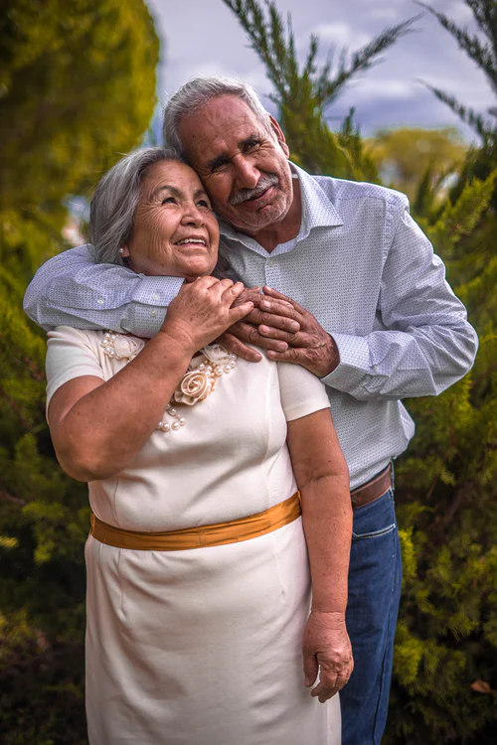
Couple Conversation
Marital Support System
Notes:
[Play soft music during this time]

Slide 16
Serving
{"A?":"B","a":5,"d":"B","h":"www.canva.com","c":"DAEgbdBprh8","i":"FnFG1mVckmNm2nHbe8Jk-w","b":1626545686976,"A":[{"A?":"H","A":577.6594676811845,"B":869.7560883241679,"D":158.8290593032107,"C":152.07900524417002,"b":179.66692039007123,"a":172.03128097638478,"c":[{"A?":"I","A":1.4210854715202004e-14,"B":-1.4210854715202004e-14,"D":179.66692039007128,"C":172.03128097638475,"a":{"A":false,"C":"#cced00"}},{"A?":"I","A":35.67732265908816,"B":39.4951423659314,"D":100.67663565820844,"C":100.67663565820844,"N":"illustration","a":{"A":false,"B":{"A":{"A":"MAB0QaOUxuU","B":2},"B":{"D":100.67663565820844,"C":100.67663565820844},"C":{"#010101":"#1b1a1a"}}}}]}],"B":1920,"C":1080}

Slide 17
“For whosoever will save his life shall lose it; and whosoever shall lose his life for my sake shall find it.”
Matthew 16:25

Slide 18
Couple generativity increases couple identity and strength.

Slide 19
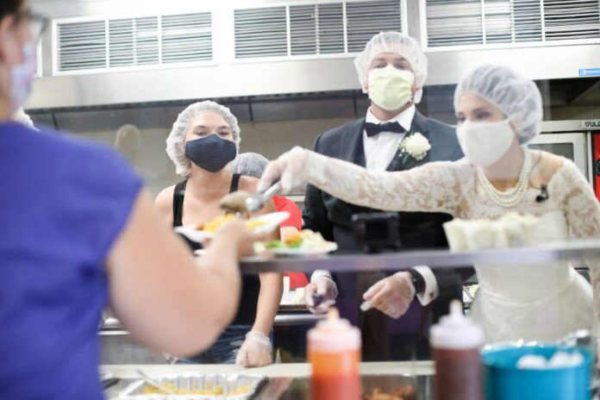
goodnewsnetwork.org, 4 Sep 2020, credit Caroline Stoltzfus/The City Mission

Slide 20
“Responsible citizens everywhere… [are called] to promote those measures designed to maintain and strengthen the family as the fundamental unity of society.” The Family Proclamation

Slide 21
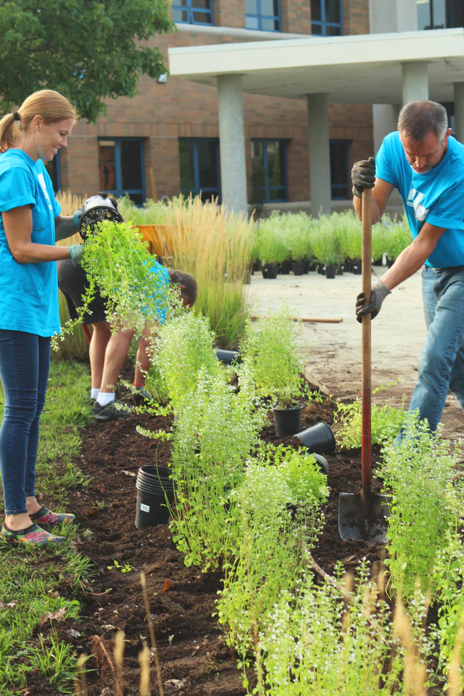
Couple Conversation
Serving
Notes:
[Play soft music during this time]

Slide 22
Congratulations!
{"A?":"B","a":5,"d":"B","h":"www.canva.com","c":"DAEgbdBprh8","i":"FnFG1mVckmNm2nHbe8Jk-w","b":1626545686976,"A":[{"A?":"H","A":577.6594676811845,"B":869.7560883241679,"D":158.8290593032107,"C":152.07900524417002,"b":179.66692039007123,"a":172.03128097638478,"c":[{"A?":"I","A":1.4210854715202004e-14,"B":-1.4210854715202004e-14,"D":179.66692039007128,"C":172.03128097638475,"a":{"A":false,"C":"#cced00"}},{"A?":"I","A":35.67732265908816,"B":39.4951423659314,"D":100.67663565820844,"C":100.67663565820844,"N":"illustration","a":{"A":false,"B":{"A":{"A":"MAB0QaOUxuU","B":2},"B":{"D":100.67663565820844,"C":100.67663565820844},"C":{"#010101":"#1b1a1a"}}}}]}],"B":1920,"C":1080}

Slide 23
“Whatever Jesus lays his hands upon lives. If Jesus lays his hands upon a marriage, it lives.”
- President Howard W. Hunter

Slide 24
Stay in touch!
Website:
AnxiouslyEngaged.byu.edu
Email: anxiously.engaged.marriage.prep@gmail.com
Notes:
www.freepik.com

Slide 25
Marriage License
Discount Reminder
{"A?":"B","a":5,"d":"B","h":"www.canva.com","c":"DAEgbdBprh8","i":"FnFG1mVckmNm2nHbe8Jk-w","b":1626545686976,"A":[{"A?":"H","A":577.6594676811845,"B":869.7560883241679,"D":158.8290593032107,"C":152.07900524417002,"b":179.66692039007123,"a":172.03128097638478,"c":[{"A?":"I","A":1.4210854715202004e-14,"B":-1.4210854715202004e-14,"D":179.66692039007128,"C":172.03128097638475,"a":{"A":false,"C":"#cced00"}},{"A?":"I","A":35.67732265908816,"B":39.4951423659314,"D":100.67663565820844,"C":100.67663565820844,"N":"illustration","a":{"A":false,"B":{"A":{"A":"MAB0QaOUxuU","B":2},"B":{"D":100.67663565820844,"C":100.67663565820844},"C":{"#010101":"#1b1a1a"}}}}]}],"B":1920,"C":1080}

Slide 26
Homework
{"A?":"B","a":5,"d":"B","h":"www.canva.com","c":"DAEgbdBprh8","i":"FnFG1mVckmNm2nHbe8Jk-w","b":1626545686976,"A":[{"A?":"H","A":577.6594676811845,"B":869.7560883241679,"D":158.8290593032107,"C":152.07900524417002,"b":179.66692039007123,"a":172.03128097638478,"c":[{"A?":"I","A":1.4210854715202004e-14,"B":-1.4210854715202004e-14,"D":179.66692039007128,"C":172.03128097638475,"a":{"A":false,"C":"#cced00"}},{"A?":"I","A":35.67732265908816,"B":39.4951423659314,"D":100.67663565820844,"C":100.67663565820844,"N":"illustration","a":{"A":false,"B":{"A":{"A":"MAB0QaOUxuU","B":2},"B":{"D":100.67663565820844,"C":100.67663565820844},"C":{"#010101":"#1b1a1a"}}}}]}],"B":1920,"C":1080}
Share your commitment
in a special way
Decide on the next step of your “marriage program”
Choose a mentor?
Read a book?
Do a supplemental lesson?
Notes:
www.freepik.com

