Slide 1

Lesson 5: Becoming One Through Growing Together

Slide 2
What is entropy?

Slide 3
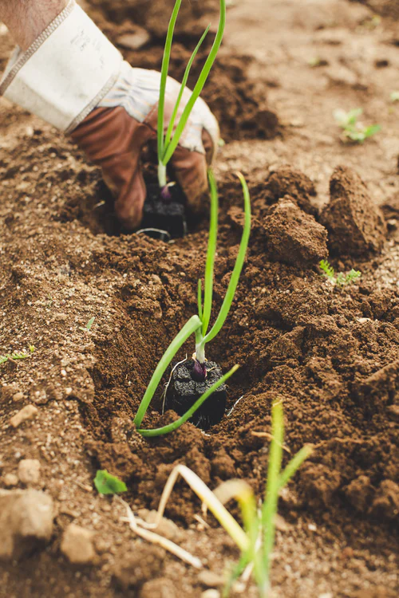
Intentionally
Nurturing our Marriage
Investing
Learning
Serving

Slide 4
Investing
{"A?":"B","a":5,"d":"B","h":"www.canva.com","c":"DAEgbdBprh8","i":"FnFG1mVckmNm2nHbe8Jk-w","b":1626545686976,"A":[{"A?":"H","A":577.6594676811845,"B":869.7560883241679,"D":158.8290593032107,"C":152.07900524417002,"b":179.66692039007123,"a":172.03128097638478,"c":[{"A?":"I","A":1.4210854715202004e-14,"B":-1.4210854715202004e-14,"D":179.66692039007128,"C":172.03128097638475,"a":{"A":false,"C":"#cced00"}},{"A?":"I","A":35.67732265908816,"B":39.4951423659314,"D":100.67663565820844,"C":100.67663565820844,"N":"illustration","a":{"A":false,"B":{"A":{"A":"MAB0QaOUxuU","B":2},"B":{"D":100.67663565820844,"C":100.67663565820844},"C":{"#010101":"#1b1a1a"}}}}]}],"B":1920,"C":1080}

Slide 5
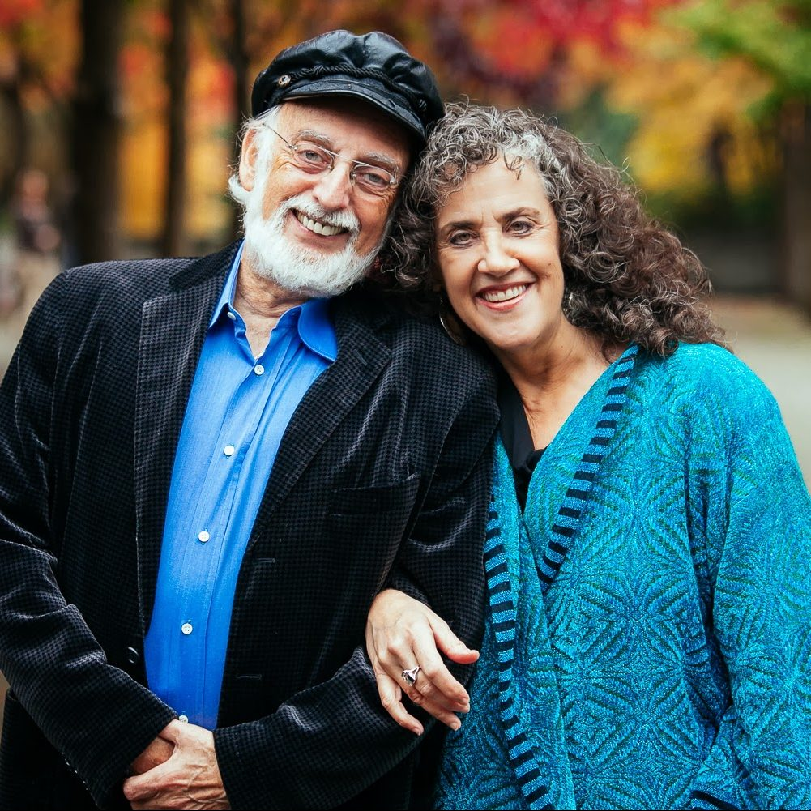
The Magic 6 Hours
Dr. John Gottman

Slide 6
Gottman’s Magic Six Hours:
1. Partings | 2 min/day = 10 min/week
2. Reunions | 20 min/day = 1 hr 40 min/week
3. Admiration and Appreciation | 5 min/day = 35 min/week
4. Affection | 5 min/day = 35 min/week
5. Weekly Date | 2 hr/week
6. State of the Union Meeting | 1 hr/week
Notes:
See gottman.com

Slide 7

Couple Time
Magic 6 Hours
Notes:
[Play soft music during this time]
ASK: Does anyone have any thoughts on the Magic 6 Hours they want to share?

Slide 8
Learning
{"A?":"B","a":5,"d":"B","h":"www.canva.com","c":"DAEgbdBprh8","i":"FnFG1mVckmNm2nHbe8Jk-w","b":1626545686976,"A":[{"A?":"H","A":577.6594676811845,"B":869.7560883241679,"D":158.8290593032107,"C":152.07900524417002,"b":179.66692039007123,"a":172.03128097638478,"c":[{"A?":"I","A":1.4210854715202004e-14,"B":-1.4210854715202004e-14,"D":179.66692039007128,"C":172.03128097638475,"a":{"A":false,"C":"#cced00"}},{"A?":"I","A":35.67732265908816,"B":39.4951423659314,"D":100.67663565820844,"C":100.67663565820844,"N":"illustration","a":{"A":false,"B":{"A":{"A":"MAB0QaOUxuU","B":2},"B":{"D":100.67663565820844,"C":100.67663565820844},"C":{"#010101":"#1b1a1a"}}}}]}],"B":1920,"C":1080}

Slide 9
When properly done, seeking help from others does not break the loyalty you have built.

Slide 10
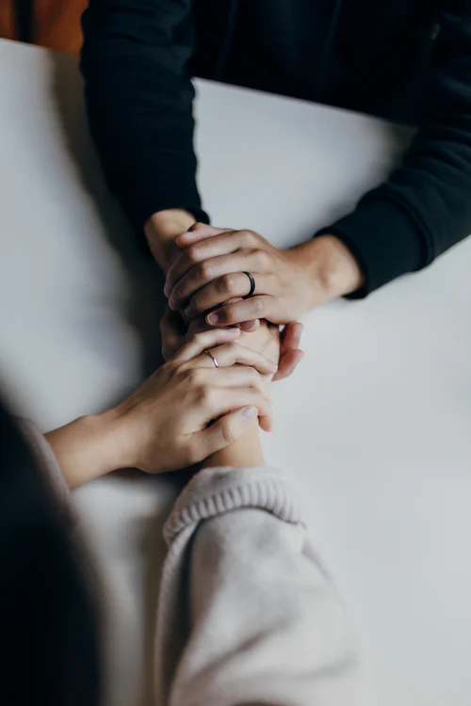
Group Discussion
  What are some good ways we can reach out together for support?
  What are principles that can guide how we do this?

Slide 11

Seeking Outside Help
Mentors
Marital Support System
Other Resources

Slide 12
Mentors
{"A?":"B","a":5,"d":"B","h":"www.canva.com","c":"DAEgbdBprh8","i":"FnFG1mVckmNm2nHbe8Jk-w","b":1626545686976,"A":[{"A?":"H","A":577.6594676811845,"B":869.7560883241679,"D":158.8290593032107,"C":152.07900524417002,"b":179.66692039007123,"a":172.03128097638478,"c":[{"A?":"I","A":1.4210854715202004e-14,"B":-1.4210854715202004e-14,"D":179.66692039007128,"C":172.03128097638475,"a":{"A":false,"C":"#cced00"}},{"A?":"I","A":35.67732265908816,"B":39.4951423659314,"D":100.67663565820844,"C":100.67663565820844,"N":"illustration","a":{"A":false,"B":{"A":{"A":"MAB0QaOUxuU","B":2},"B":{"D":100.67663565820844,"C":100.67663565820844},"C":{"#010101":"#1b1a1a"}}}}]}],"B":1920,"C":1080}
Notes:
www.freepik.com

Slide 13
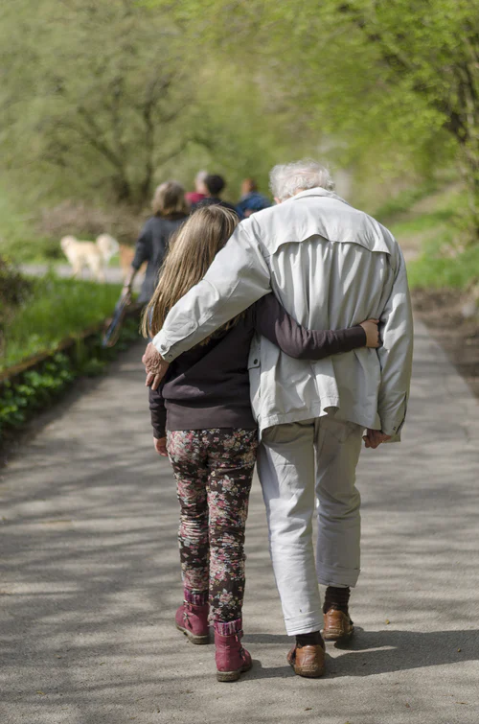
Mentors
  Who have been your mentors, in any area of life?
  Have mentors been a valuable resource for you?
Notes:
www.freepik.com

Slide 14
Mentors are intended to help your marriage flourish and avoid pitfalls.

Slide 15
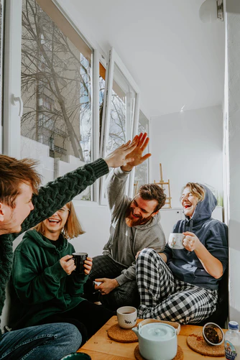

Marital Support
System
Notes:
www.freepik.com

Slide 16

Other
Resources
Notes:
www.freepik.com

Slide 17


Resources
{"A?":"B","a":5,"d":"B","h":"www.canva.com","c":"DAEgbdBprh8","i":"FnFG1mVckmNm2nHbe8Jk-w","b":1626545686976,"A":[{"A?":"H","A":577.6594676811845,"B":869.7560883241679,"D":158.8290593032107,"C":152.07900524417002,"b":179.66692039007123,"a":172.03128097638478,"c":[{"A?":"I","A":1.4210854715202004e-14,"B":-1.4210854715202004e-14,"D":179.66692039007128,"C":172.03128097638475,"a":{"A":false,"C":"#cced00"}},{"A?":"I","A":35.67732265908816,"B":39.4951423659314,"D":100.67663565820844,"C":100.67663565820844,"N":"illustration","a":{"A":false,"B":{"A":{"A":"MAB0QaOUxuU","B":2},"B":{"D":100.67663565820844,"C":100.67663565820844},"C":{"#010101":"#1b1a1a"}}}}]}],"B":1920,"C":1080}
Notes:
www.freepik.com

Slide 18
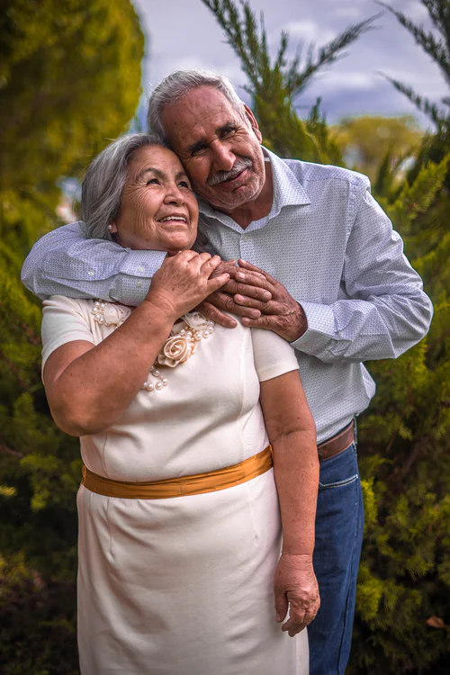
Couple Time
Mentors
Notes:
[Play soft music during this time]

Slide 19
Serving
{"A?":"B","a":5,"d":"B","h":"www.canva.com","c":"DAEgbdBprh8","i":"FnFG1mVckmNm2nHbe8Jk-w","b":1626545686976,"A":[{"A?":"H","A":577.6594676811845,"B":869.7560883241679,"D":158.8290593032107,"C":152.07900524417002,"b":179.66692039007123,"a":172.03128097638478,"c":[{"A?":"I","A":1.4210854715202004e-14,"B":-1.4210854715202004e-14,"D":179.66692039007128,"C":172.03128097638475,"a":{"A":false,"C":"#cced00"}},{"A?":"I","A":35.67732265908816,"B":39.4951423659314,"D":100.67663565820844,"C":100.67663565820844,"N":"illustration","a":{"A":false,"B":{"A":{"A":"MAB0QaOUxuU","B":2},"B":{"D":100.67663565820844,"C":100.67663565820844},"C":{"#010101":"#1b1a1a"}}}}]}],"B":1920,"C":1080}

Slide 20
“For whosoever will save his life shall lose it; and whosoever shall lose his life for my sake shall find it.”
Matthew 16:25

Slide 21
Couple generativity increases couple identity and strength.

Slide 22
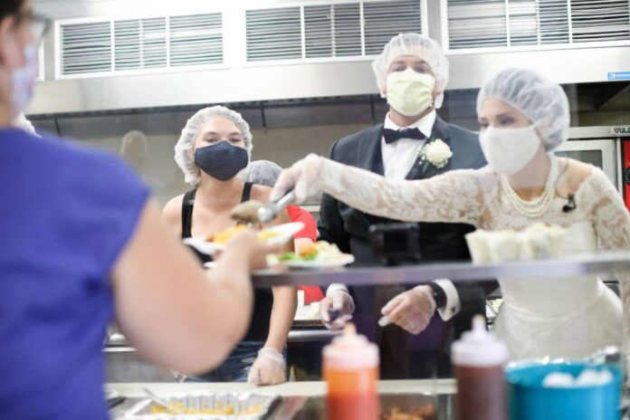
goodnewsnetwork.org, 4 Sep 2020, credit Caroline Stoltzfus/The City Mission

Slide 23
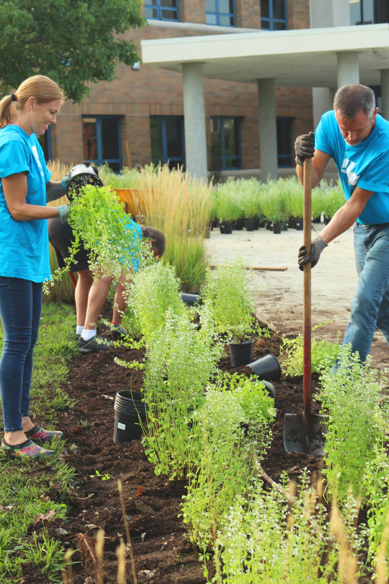
Couple Time
Serving
Notes:
[Play soft music during this time]

Slide 24
Congratulations!
{"A?":"B","a":5,"d":"B","h":"www.canva.com","c":"DAEgbdBprh8","i":"FnFG1mVckmNm2nHbe8Jk-w","b":1626545686976,"A":[{"A?":"H","A":577.6594676811845,"B":869.7560883241679,"D":158.8290593032107,"C":152.07900524417002,"b":179.66692039007123,"a":172.03128097638478,"c":[{"A?":"I","A":1.4210854715202004e-14,"B":-1.4210854715202004e-14,"D":179.66692039007128,"C":172.03128097638475,"a":{"A":false,"C":"#cced00"}},{"A?":"I","A":35.67732265908816,"B":39.4951423659314,"D":100.67663565820844,"C":100.67663565820844,"N":"illustration","a":{"A":false,"B":{"A":{"A":"MAB0QaOUxuU","B":2},"B":{"D":100.67663565820844,"C":100.67663565820844},"C":{"#010101":"#1b1a1a"}}}}]}],"B":1920,"C":1080}

Slide 25
“Whatever Jesus lays his hands upon lives. If Jesus lays his hands upon a marriage, it lives.”
- Howard W. Hunter

Slide 26
Stay in touch!
  Website: AnxiouslyEngaged.byu.edu
  Instagram: @anxiously__engaged
  Facebook: Anxiously Engaged
  Email: anxiouslyengaged2.0@gmail.com
Notes:
www.freepik.com

Slide 27
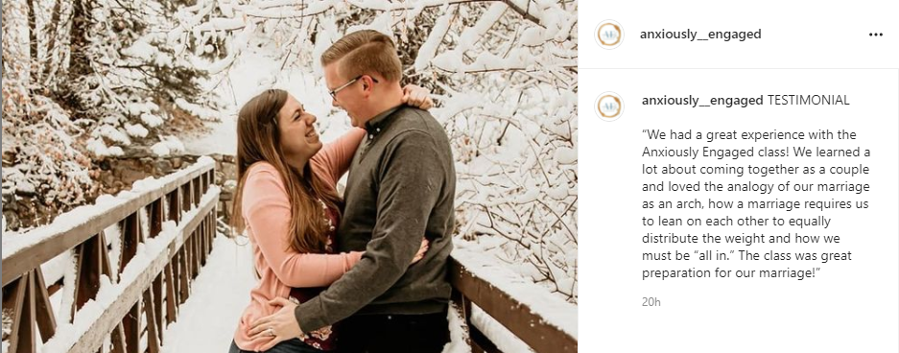
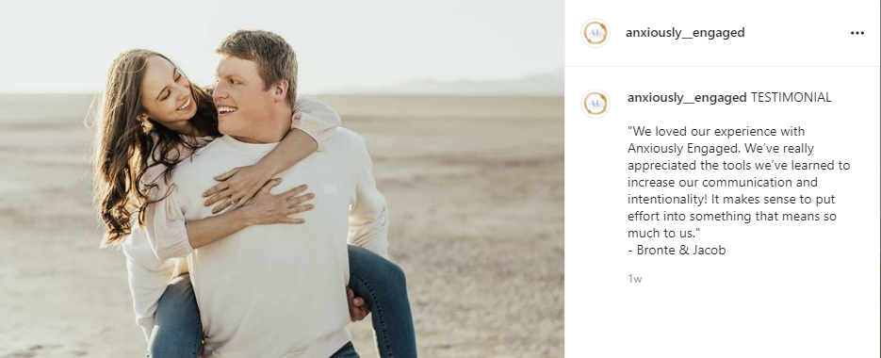
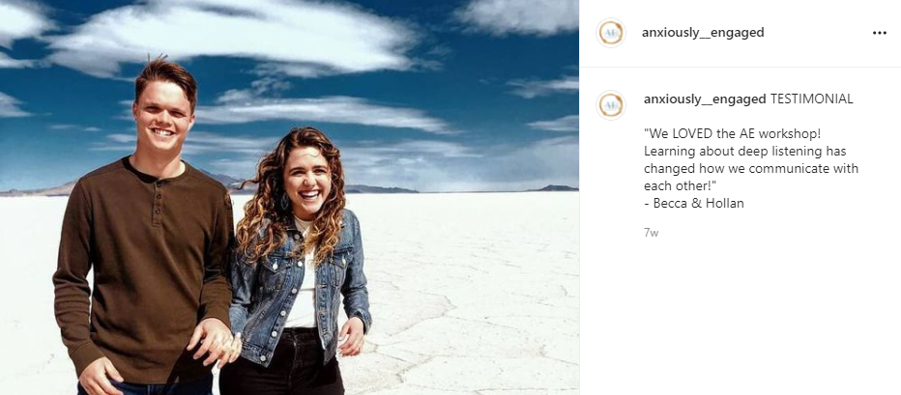
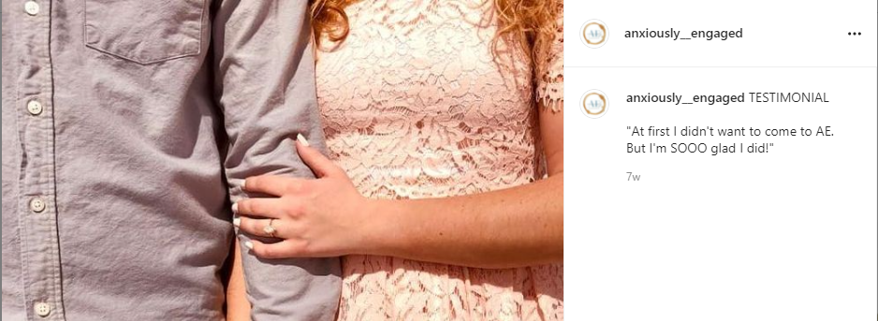
Testimonials & Referrals

Slide 28
Marriage License
Discount Reminder
{"A?":"B","a":5,"d":"B","h":"www.canva.com","c":"DAEgbdBprh8","i":"FnFG1mVckmNm2nHbe8Jk-w","b":1626545686976,"A":[{"A?":"H","A":577.6594676811845,"B":869.7560883241679,"D":158.8290593032107,"C":152.07900524417002,"b":179.66692039007123,"a":172.03128097638478,"c":[{"A?":"I","A":1.4210854715202004e-14,"B":-1.4210854715202004e-14,"D":179.66692039007128,"C":172.03128097638475,"a":{"A":false,"C":"#cced00"}},{"A?":"I","A":35.67732265908816,"B":39.4951423659314,"D":100.67663565820844,"C":100.67663565820844,"N":"illustration","a":{"A":false,"B":{"A":{"A":"MAB0QaOUxuU","B":2},"B":{"D":100.67663565820844,"C":100.67663565820844},"C":{"#010101":"#1b1a1a"}}}}]}],"B":1920,"C":1080}

Slide 29
Homework
{"A?":"B","a":5,"d":"B","h":"www.canva.com","c":"DAEgbdBprh8","i":"FnFG1mVckmNm2nHbe8Jk-w","b":1626545686976,"A":[{"A?":"H","A":577.6594676811845,"B":869.7560883241679,"D":158.8290593032107,"C":152.07900524417002,"b":179.66692039007123,"a":172.03128097638478,"c":[{"A?":"I","A":1.4210854715202004e-14,"B":-1.4210854715202004e-14,"D":179.66692039007128,"C":172.03128097638475,"a":{"A":false,"C":"#cced00"}},{"A?":"I","A":35.67732265908816,"B":39.4951423659314,"D":100.67663565820844,"C":100.67663565820844,"N":"illustration","a":{"A":false,"B":{"A":{"A":"MAB0QaOUxuU","B":2},"B":{"D":100.67663565820844,"C":100.67663565820844},"C":{"#010101":"#1b1a1a"}}}}]}],"B":1920,"C":1080}
  Share your commitment
in a special way
  Decide on the next step of your “marriage program”
    Choose a mentor?
    Read a book?
    Do a supplemental lesson?
Notes:
www.freepik.com

