Slide 1

Lesson 4: Becoming One Through Equal Partnership
& Complete Commitment

Slide 2
Developing an equal partnership
Committing completely
Growing together
Today

Slide 3
Developing an Equal Partnership
{"A?":"B","a":5,"d":"B","h":"www.canva.com","c":"DAEgbdBprh8","i":"FnFG1mVckmNm2nHbe8Jk-w","b":1626545686976,"A":[{"A?":"H","A":577.6594676811845,"B":869.7560883241679,"D":158.8290593032107,"C":152.07900524417002,"b":179.66692039007123,"a":172.03128097638478,"c":[{"A?":"I","A":1.4210854715202004e-14,"B":-1.4210854715202004e-14,"D":179.66692039007128,"C":172.03128097638475,"a":{"A":false,"C":"#cced00"}},{"A?":"I","A":35.67732265908816,"B":39.4951423659314,"D":100.67663565820844,"C":100.67663565820844,"N":"illustration","a":{"A":false,"B":{"A":{"A":"MAB0QaOUxuU","B":2},"B":{"D":100.67663565820844,"C":100.67663565820844},"C":{"#010101":"#1b1a1a"}}}}]}],"B":1920,"C":1080}

Slide 4
“In the marriage companionship there is neither inferiority nor superiority. The woman does not walk ahead of the man; neither does the man walk ahead of the woman. They walk side by side as a son and daughter of God on an eternal journey.”
- Gordon B. Hinckley

Slide 5
Happier relationships
Greater marital satisfaction
More sexual satisfaction
Better individual well-being
Less depression
More effective co-parenting
Better functioning children
Less verbal aggression and physical violence
Benefits of
Equal Partnership

Slide 6
Cultural & Faith Misunderstandings
{"A?":"B","a":5,"d":"B","h":"www.canva.com","c":"DAEgbdBprh8","i":"FnFG1mVckmNm2nHbe8Jk-w","b":1626545686976,"A":[{"A?":"H","A":577.6594676811845,"B":869.7560883241679,"D":158.8290593032107,"C":152.07900524417002,"b":179.66692039007123,"a":172.03128097638478,"c":[{"A?":"I","A":1.4210854715202004e-14,"B":-1.4210854715202004e-14,"D":179.66692039007128,"C":172.03128097638475,"a":{"A":false,"C":"#cced00"}},{"A?":"I","A":35.67732265908816,"B":39.4951423659314,"D":100.67663565820844,"C":100.67663565820844,"N":"illustration","a":{"A":false,"B":{"A":{"A":"MAB0QaOUxuU","B":2},"B":{"D":100.67663565820844,"C":100.67663565820844},"C":{"#010101":"#1b1a1a"}}}}]}],"B":1920,"C":1080}
Notes:
ASK: Can you think of some general cultural traditions (current and historical) that don’t view women as equal?
ASK: Can you think of any of the teachings of our faith that have sometimes been misunderstood to see women as less than equal?

Slide 7
Decision Making
{"A?":"B","a":5,"d":"B","h":"www.canva.com","c":"DAEgbdBprh8","i":"FnFG1mVckmNm2nHbe8Jk-w","b":1626545686976,"A":[{"A?":"H","A":577.6594676811845,"B":869.7560883241679,"D":158.8290593032107,"C":152.07900524417002,"b":179.66692039007123,"a":172.03128097638478,"c":[{"A?":"I","A":1.4210854715202004e-14,"B":-1.4210854715202004e-14,"D":179.66692039007128,"C":172.03128097638475,"a":{"A":false,"C":"#cced00"}},{"A?":"I","A":35.67732265908816,"B":39.4951423659314,"D":100.67663565820844,"C":100.67663565820844,"N":"illustration","a":{"A":false,"B":{"A":{"A":"MAB0QaOUxuU","B":2},"B":{"D":100.67663565820844,"C":100.67663565820844},"C":{"#010101":"#1b1a1a"}}}}]}],"B":1920,"C":1080}

Slide 8
[A husband and wife] “have equal power to receive revelation for their family. When they work together in love and righteousness, their decisions are heaven blessed.”
- Quentin L. Cook

Slide 9

Couple Time
Equal Partnership
Notes:
[Play soft music during this time]

Slide 10
Committing Completely
{"A?":"B","a":5,"d":"B","h":"www.canva.com","c":"DAEgbdBprh8","i":"FnFG1mVckmNm2nHbe8Jk-w","b":1626545686976,"A":[{"A?":"H","A":577.6594676811845,"B":869.7560883241679,"D":158.8290593032107,"C":152.07900524417002,"b":179.66692039007123,"a":172.03128097638478,"c":[{"A?":"I","A":1.4210854715202004e-14,"B":-1.4210854715202004e-14,"D":179.66692039007128,"C":172.03128097638475,"a":{"A":false,"C":"#cced00"}},{"A?":"I","A":35.67732265908816,"B":39.4951423659314,"D":100.67663565820844,"C":100.67663565820844,"N":"illustration","a":{"A":false,"B":{"A":{"A":"MAB0QaOUxuU","B":2},"B":{"D":100.67663565820844,"C":100.67663565820844},"C":{"#010101":"#1b1a1a"}}}}]}],"B":1920,"C":1080}

Slide 11
“Marriage is the sort of thing where it’s safer to go all in, and it’s dangerous to go in half-hearted. At the far end, when done well, you see people enjoying the deepest steady joy you can find on this earth.”
- David Brooks
Notes:
ASK: What could be dangerous about going into marriage “half-hearted?”

Slide 12
Divorce Research
{"A?":"B","a":5,"d":"B","h":"www.canva.com","c":"DAEgbdBprh8","i":"FnFG1mVckmNm2nHbe8Jk-w","b":1626545686976,"A":[{"A?":"H","A":577.6594676811845,"B":869.7560883241679,"D":158.8290593032107,"C":152.07900524417002,"b":179.66692039007123,"a":172.03128097638478,"c":[{"A?":"I","A":1.4210854715202004e-14,"B":-1.4210854715202004e-14,"D":179.66692039007128,"C":172.03128097638475,"a":{"A":false,"C":"#cced00"}},{"A?":"I","A":35.67732265908816,"B":39.4951423659314,"D":100.67663565820844,"C":100.67663565820844,"N":"illustration","a":{"A":false,"B":{"A":{"A":"MAB0QaOUxuU","B":2},"B":{"D":100.67663565820844,"C":100.67663565820844},"C":{"#010101":"#1b1a1a"}}}}]}],"B":1920,"C":1080}

Slide 13
“What God hath joined together, let not man put asunder.”
Matthew 19:6

Slide 14
The #1 reason for divorce:
lack of commitment

Slide 15
Divorce Statistics
In the US
40% of first marriages
60% of second marriages
end in divorce

Slide 16
Teachings on Divorce
{"A?":"B","a":5,"d":"B","h":"www.canva.com","c":"DAEgbdBprh8","i":"FnFG1mVckmNm2nHbe8Jk-w","b":1626545686976,"A":[{"A?":"H","A":577.6594676811845,"B":869.7560883241679,"D":158.8290593032107,"C":152.07900524417002,"b":179.66692039007123,"a":172.03128097638478,"c":[{"A?":"I","A":1.4210854715202004e-14,"B":-1.4210854715202004e-14,"D":179.66692039007128,"C":172.03128097638475,"a":{"A":false,"C":"#cced00"}},{"A?":"I","A":35.67732265908816,"B":39.4951423659314,"D":100.67663565820844,"C":100.67663565820844,"N":"illustration","a":{"A":false,"B":{"A":{"A":"MAB0QaOUxuU","B":2},"B":{"D":100.67663565820844,"C":100.67663565820844},"C":{"#010101":"#1b1a1a"}}}}]}],"B":1920,"C":1080}

Slide 17
“There may be now and again a legitimate cause for divorce. I am not one to say that it is never justified. But I say without hesitation that this plague among us, which seems to be growing everywhere, is not of God.”
- Gordon B. Hinckley

Slide 18
“What, then, might be ‘just cause’ for breaking the covenants of marriage? Over a lifetime of dealing with human problems, I have struggled to understand what might be considered ‘just cause’ for breaking of covenants. I confess I do not claim the wisdom nor authority to definitively state what is ‘just cause.’ Only the parties to the marriage can determine this. . . . In my opinion, ‘just cause’ should be nothing less serious than a prolonged and apparently irredeemable relationship which is destructive of a person’s dignity as a human being.”
- James E. Faust

Slide 19

3 Wise Tests
Length of marital difficulties
“Apparently irredeemable” relationship
Destructive of our dignity as a child of God

Slide 20
“Under the law of the Lord, a marriage,
like a human life, is a precious living thing. If our bodies are sick, we seek to heal them. We do not give up. While there is any prospect of life, we seek healing again and again. The same should be true of our marriages, and if we seek Him, the Lord will help us and heal us. . . . Of course, there can be times when one spouse falls short and the other is wounded and feels pain. When that happens, the one who is wronged should balance current disappointments against the good of the past and the brighter prospects of the future.”
- Dallin H. Oaks

Slide 21
3 Wise Tests
Length of marital difficulties
“Apparently irredeemable” relationship
Destructive of our dignity as a child of God

Slide 22
“When a marriage is dead and beyond hope of resuscitation, it is needful to have a means to end it.”
-Dallin H. Oaks

Slide 23

Couple Time
Divorce Philosophy
Notes:
[Play soft music during this time]

Slide 24
Conclusion
{"A?":"B","a":5,"d":"B","h":"www.canva.com","c":"DAEgbdBprh8","i":"FnFG1mVckmNm2nHbe8Jk-w","b":1626545686976,"A":[{"A?":"H","A":577.6594676811845,"B":869.7560883241679,"D":158.8290593032107,"C":152.07900524417002,"b":179.66692039007123,"a":172.03128097638478,"c":[{"A?":"I","A":1.4210854715202004e-14,"B":-1.4210854715202004e-14,"D":179.66692039007128,"C":172.03128097638475,"a":{"A":false,"C":"#cced00"}},{"A?":"I","A":35.67732265908816,"B":39.4951423659314,"D":100.67663565820844,"C":100.67663565820844,"N":"illustration","a":{"A":false,"B":{"A":{"A":"MAB0QaOUxuU","B":2},"B":{"D":100.67663565820844,"C":100.67663565820844},"C":{"#010101":"#1b1a1a"}}}}]}],"B":1920,"C":1080}

Slide 25
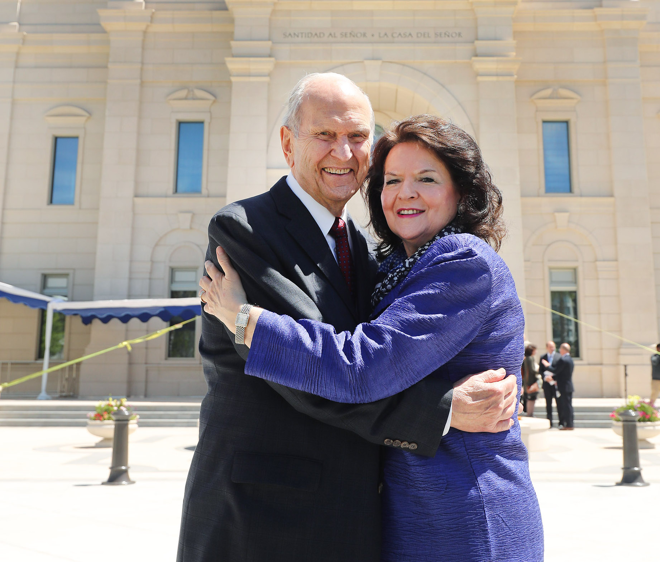
“Marriage brings greater possibilities for happiness than does any other human relationship.”
- Russell M. Nelson

Slide 26

Break Time!

