Slide 1

Lesson 1: Becoming One in Marriage
Welcome to Anxiously Engaged- I’m so glad you are here!
Please turn on your cameras and rename your Zoom ID
to include both of your first names.

Slide 2

Couple Discussion
What is one thing you would like to learn from participating in Anxiously Engaged?

Slide 3
Follow Us:
{"A?":"B","a":5,"d":"B","h":"www.canva.com","c":"DAEgbdBprh8","i":"FnFG1mVckmNm2nHbe8Jk-w","b":1626545686976,"A":[{"A?":"H","A":577.6594676811845,"B":869.7560883241679,"D":158.8290593032107,"C":152.07900524417002,"b":179.66692039007123,"a":172.03128097638478,"c":[{"A?":"I","A":1.4210854715202004e-14,"B":-1.4210854715202004e-14,"D":179.66692039007128,"C":172.03128097638475,"a":{"A":false,"C":"#cced00"}},{"A?":"I","A":35.67732265908816,"B":39.4951423659314,"D":100.67663565820844,"C":100.67663565820844,"N":"illustration","a":{"A":false,"B":{"A":{"A":"MAB0QaOUxuU","B":2},"B":{"D":100.67663565820844,"C":100.67663565820844},"C":{"#010101":"#1b1a1a"}}}}]}],"B":1920,"C":1080}
@anxiously__engaged
Anxiously Engaged
www.AnxiouslyEngaged.byu.edu

Slide 4
Anxiously Engaged Overview
{"A?":"B","a":5,"d":"B","h":"www.canva.com","c":"DAEgbdBprh8","i":"FnFG1mVckmNm2nHbe8Jk-w","b":1626545686976,"A":[{"A?":"H","A":577.6594676811845,"B":869.7560883241679,"D":158.8290593032107,"C":152.07900524417002,"b":179.66692039007123,"a":172.03128097638478,"c":[{"A?":"I","A":1.4210854715202004e-14,"B":-1.4210854715202004e-14,"D":179.66692039007128,"C":172.03128097638475,"a":{"A":false,"C":"#cced00"}},{"A?":"I","A":35.67732265908816,"B":39.4951423659314,"D":100.67663565820844,"C":100.67663565820844,"N":"illustration","a":{"A":false,"B":{"A":{"A":"MAB0QaOUxuU","B":2},"B":{"D":100.67663565820844,"C":100.67663565820844},"C":{"#010101":"#1b1a1a"}}}}]}],"B":1920,"C":1080}
Help couples intentionally prepare for marriage
Help couples work toward becoming one

Slide 5
“Verily I say, men should be anxiously engaged in a good cause, and do many things of their own free will, and bring to pass much righteousness; For the power is in them, wherein they are agents unto themselves. And inasmuch as men do good they shall in nowise lose their reward.”
D&C 58:27-28

Slide 6
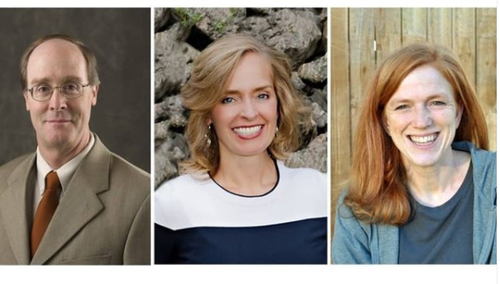
Anxiously Engaged Creators
Dr. Alan Hawkins, Kathryn Pond Sargent, Tamara Gilliland

Slide 7


Faith-based &
Research-based

Slide 8
Intentional Marriage Preparation:
helps avoid some of the disappointing bumps of early-married life
increases the chances of forming healthy, happy marriages
1
2
3
decreases the chances of divorce

Slide 9

“Decide, don’t slide”
Dr. Scott Stanley
Talking about important decisions now will help reduce confusion, disappointment and conflict.

Slide 10
Anxiously Engaged Format
{"A?":"B","a":5,"d":"B","h":"www.canva.com","c":"DAEgbdBprh8","i":"FnFG1mVckmNm2nHbe8Jk-w","b":1626545686976,"A":[{"A?":"H","A":577.6594676811845,"B":869.7560883241679,"D":158.8290593032107,"C":152.07900524417002,"b":179.66692039007123,"a":172.03128097638478,"c":[{"A?":"I","A":1.4210854715202004e-14,"B":-1.4210854715202004e-14,"D":179.66692039007128,"C":172.03128097638475,"a":{"A":false,"C":"#cced00"}},{"A?":"I","A":35.67732265908816,"B":39.4951423659314,"D":100.67663565820844,"C":100.67663565820844,"N":"illustration","a":{"A":false,"B":{"A":{"A":"MAB0QaOUxuU","B":2},"B":{"D":100.67663565820844,"C":100.67663565820844},"C":{"#010101":"#1b1a1a"}}}}]}],"B":1920,"C":1080}

Slide 11
  Lesson 1: Becoming One
  Lesson 2: Effective Communication
Lessons 3 - 4: Marital Sexuality
Lesson 5: Equal Partnership and
Complete Commitment
Lesson 6: Growing Together
Core Lessons

Slide 12
Utah
Florida
Georgia
Maryland
Minnesota
Oklahoma
South Carolina
Tennessee
Texas
West Virginia
Marriage License Discounts

Slide 13
Becoming One in Marriage
{"A?":"B","a":5,"d":"B","h":"www.canva.com","c":"DAEgbdBprh8","i":"FnFG1mVckmNm2nHbe8Jk-w","b":1626545686976,"A":[{"A?":"H","A":577.6594676811845,"B":869.7560883241679,"D":158.8290593032107,"C":152.07900524417002,"b":179.66692039007123,"a":172.03128097638478,"c":[{"A?":"I","A":1.4210854715202004e-14,"B":-1.4210854715202004e-14,"D":179.66692039007128,"C":172.03128097638475,"a":{"A":false,"C":"#cced00"}},{"A?":"I","A":35.67732265908816,"B":39.4951423659314,"D":100.67663565820844,"C":100.67663565820844,"N":"illustration","a":{"A":false,"B":{"A":{"A":"MAB0QaOUxuU","B":2},"B":{"D":100.67663565820844,"C":100.67663565820844},"C":{"#010101":"#1b1a1a"}}}}]}],"B":1920,"C":1080}

Slide 14
“Happiness in family life is most likely to
be achieved when founded on the teachings of the
Lord Jesus Christ”
-The Family Proclamation

Slide 15
“For this cause shall a man leave his father and mother, and shall cleave to his wife; and they twain shall be one flesh. Wherefore they are no more twain, but one flesh.”
Matthew 19: 3-6

Slide 16
Me → We

Slide 17


Slide 18



Couple Conversation
Most Like an Arch This Marriage
-John Ciardi
Notes:
https://gohikevirginia.com/hiking-natural-bridge-state-park-va/
Unsplash images

Slide 19
Most Like an Arch This Marriage
- John Ciardi
Most like an arch – an entrance which upholds
and shores the stone – crush up the air like lace
Mass made idea, and idea held in place.
A lock in time. Inside half-heaven unfolds.
Most like an arch – two weaknesses that lean
into a strength. Two fallings become firm.
Two joined abeyances become a term
naming the fact that teaches fact to mean.
Not quite that? Not much less. World as it is,
what’s strong and separate falters. All I do
at piling stone on stone apart from you
is roofless around nothing. Till we kiss
I am no more than upright and unset.
It is by falling in and in we make
the all-bearing point, for one another’s sake,
in faultless failing, raised by our own weight.
Questions:
The poet Ciardi compares a marriage to an arch. What jumps out at you about this?
How are we as a couple doing with “leaning/falling in?”

Slide 20
Cleaving and Spousal
Pre-eminence
The Invisible Fence
Prioritizing “We over Me”
3 Principles of Becoming One
Notes:
Image: Light of the World by Scott Sumner

Slide 21
Cleaving and Spousal Pre-eminence
“Thou shalt love thy wife with all thy heart, and shalt cleave unto her and none else.”
D&C 42:22
Notes:
Image: Light of the World by Scott Sumner

Slide 22
“The words none else eliminate everyone and everything. The spouse then becomes pre-eminent in the life of the husband or wife and neither social life nor occupational life nor political life nor any other interest nor person nor thing shall ever take precedence over the companion spouse.”
- Spencer W. Kimball

Slide 23
  Couples must be intentional in putting their marriage first.

Slide 24
The Invisible Fence
{"A?":"B","a":5,"d":"B","h":"www.canva.com","c":"DAEgbdBprh8","i":"FnFG1mVckmNm2nHbe8Jk-w","b":1626545686976,"A":[{"A?":"H","A":577.6594676811845,"B":869.7560883241679,"D":158.8290593032107,"C":152.07900524417002,"b":179.66692039007123,"a":172.03128097638478,"c":[{"A?":"I","A":1.4210854715202004e-14,"B":-1.4210854715202004e-14,"D":179.66692039007128,"C":172.03128097638475,"a":{"A":false,"C":"#cced00"}},{"A?":"I","A":35.67732265908816,"B":39.4951423659314,"D":100.67663565820844,"C":100.67663565820844,"N":"illustration","a":{"A":false,"B":{"A":{"A":"MAB0QaOUxuU","B":2},"B":{"D":100.67663565820844,"C":100.67663565820844},"C":{"#010101":"#1b1a1a"}}}}]}],"B":1920,"C":1080}

Slide 25
A boundary to protect the sacred and intimate parts of our relationship

Slide 26
“When you are married, be fiercely loyal one to another.”
-President Gordon B. Hinckley

Slide 27

Couple Discussion
  In a general sense, what do couples do that shows their loyalty – their cleaving – to each other?
  And what do couples do – often unknowingly or unintentionally – that shows a lack of cleaving or loyalty?

Slide 28
Loyal couples:
      speak kindly about each other.
      keep their commitments to each other.
      are supportive of each other.
      discuss big decisions with each other.
      keep each other’s secrets.
      prioritize their relationship.

Slide 29
Prioritize We Over Me
{"A?":"B","a":5,"d":"B","h":"www.canva.com","c":"DAEgbdBprh8","i":"FnFG1mVckmNm2nHbe8Jk-w","b":1626545686976,"A":[{"A?":"H","A":577.6594676811845,"B":869.7560883241679,"D":158.8290593032107,"C":152.07900524417002,"b":179.66692039007123,"a":172.03128097638478,"c":[{"A?":"I","A":1.4210854715202004e-14,"B":-1.4210854715202004e-14,"D":179.66692039007128,"C":172.03128097638475,"a":{"A":false,"C":"#cced00"}},{"A?":"I","A":35.67732265908816,"B":39.4951423659314,"D":100.67663565820844,"C":100.67663565820844,"N":"illustration","a":{"A":false,"B":{"A":{"A":"MAB0QaOUxuU","B":2},"B":{"D":100.67663565820844,"C":100.67663565820844},"C":{"#010101":"#1b1a1a"}}}}]}],"B":1920,"C":1080}

Slide 30
Prioritizing
“We Over Me”
“Each party must eliminate the ‘I’ and the ‘my’ and substitute therefore ‘we’ and ‘our’”
-President Spencer W. Kimball

Slide 31
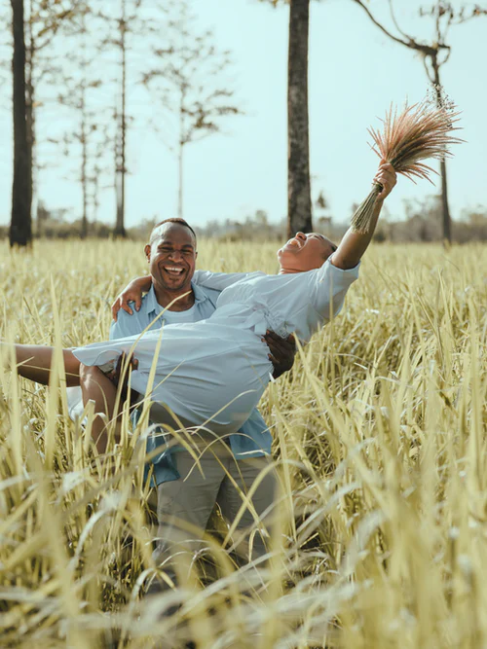
Couple Conversation
We Over Me
Notes:
https://gohikevirginia.com/hiking-natural-bridge-state-park-va/

Slide 32
Prioritize We over Me
      What struggles do I have with prioritizing we over me?
      How am I effective at prioritizing we over me?
      What are some of the benefits of thinking of we over me?
What parts of our relationship should we make sure we protect with the “invisible fence?”
      What is one thing that I can do this week that will help give greater priority to “we?”

Slide 33
Conclusion
{"A?":"B","a":5,"d":"B","h":"www.canva.com","c":"DAEgbdBprh8","i":"FnFG1mVckmNm2nHbe8Jk-w","b":1626545686976,"A":[{"A?":"H","A":577.6594676811845,"B":869.7560883241679,"D":158.8290593032107,"C":152.07900524417002,"b":179.66692039007123,"a":172.03128097638478,"c":[{"A?":"I","A":1.4210854715202004e-14,"B":-1.4210854715202004e-14,"D":179.66692039007128,"C":172.03128097638475,"a":{"A":false,"C":"#cced00"}},{"A?":"I","A":35.67732265908816,"B":39.4951423659314,"D":100.67663565820844,"C":100.67663565820844,"N":"illustration","a":{"A":false,"B":{"A":{"A":"MAB0QaOUxuU","B":2},"B":{"D":100.67663565820844,"C":100.67663565820844},"C":{"#010101":"#1b1a1a"}}}}]}],"B":1920,"C":1080}
“Happiness in marriage…can exceed a thousand times any other happiness.”
- Elder James E. Faust

Slide 34
Homework
{"A?":"B","a":5,"d":"B","h":"www.canva.com","c":"DAEgbdBprh8","i":"FnFG1mVckmNm2nHbe8Jk-w","b":1626545686976,"A":[{"A?":"H","A":577.6594676811845,"B":869.7560883241679,"D":158.8290593032107,"C":152.07900524417002,"b":179.66692039007123,"a":172.03128097638478,"c":[{"A?":"I","A":1.4210854715202004e-14,"B":-1.4210854715202004e-14,"D":179.66692039007128,"C":172.03128097638475,"a":{"A":false,"C":"#cced00"}},{"A?":"I","A":35.67732265908816,"B":39.4951423659314,"D":100.67663565820844,"C":100.67663565820844,"N":"illustration","a":{"A":false,"B":{"A":{"A":"MAB0QaOUxuU","B":2},"B":{"D":100.67663565820844,"C":100.67663565820844},"C":{"#010101":"#1b1a1a"}}}}]}],"B":1920,"C":1080}
Choose one way you can prioritize “we over me” and work on it this week.

Slide 35

Next time:
Becoming one through effective communication

