Slide 1

Lesson 6: Becoming One Through Growing Together
Please turn on your cameras and rename your Zoom ID
to include both of your first names.

Slide 2
What is entropy?

Slide 3
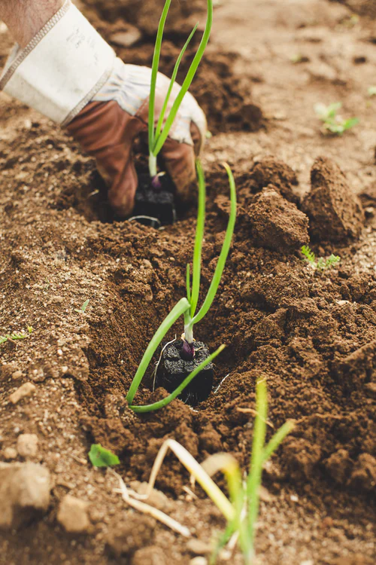
Intentionally
Nurturing our Marriage
Investing
Learning
Serving

Slide 4
Investing
{"A?":"B","a":5,"d":"B","h":"www.canva.com","c":"DAEgbdBprh8","i":"FnFG1mVckmNm2nHbe8Jk-w","b":1626545686976,"A":[{"A?":"H","A":577.6594676811845,"B":869.7560883241679,"D":158.8290593032107,"C":152.07900524417002,"b":179.66692039007123,"a":172.03128097638478,"c":[{"A?":"I","A":1.4210854715202004e-14,"B":-1.4210854715202004e-14,"D":179.66692039007128,"C":172.03128097638475,"a":{"A":false,"C":"#cced00"}},{"A?":"I","A":35.67732265908816,"B":39.4951423659314,"D":100.67663565820844,"C":100.67663565820844,"N":"illustration","a":{"A":false,"B":{"A":{"A":"MAB0QaOUxuU","B":2},"B":{"D":100.67663565820844,"C":100.67663565820844},"C":{"#010101":"#1b1a1a"}}}}]}],"B":1920,"C":1080}

Slide 5
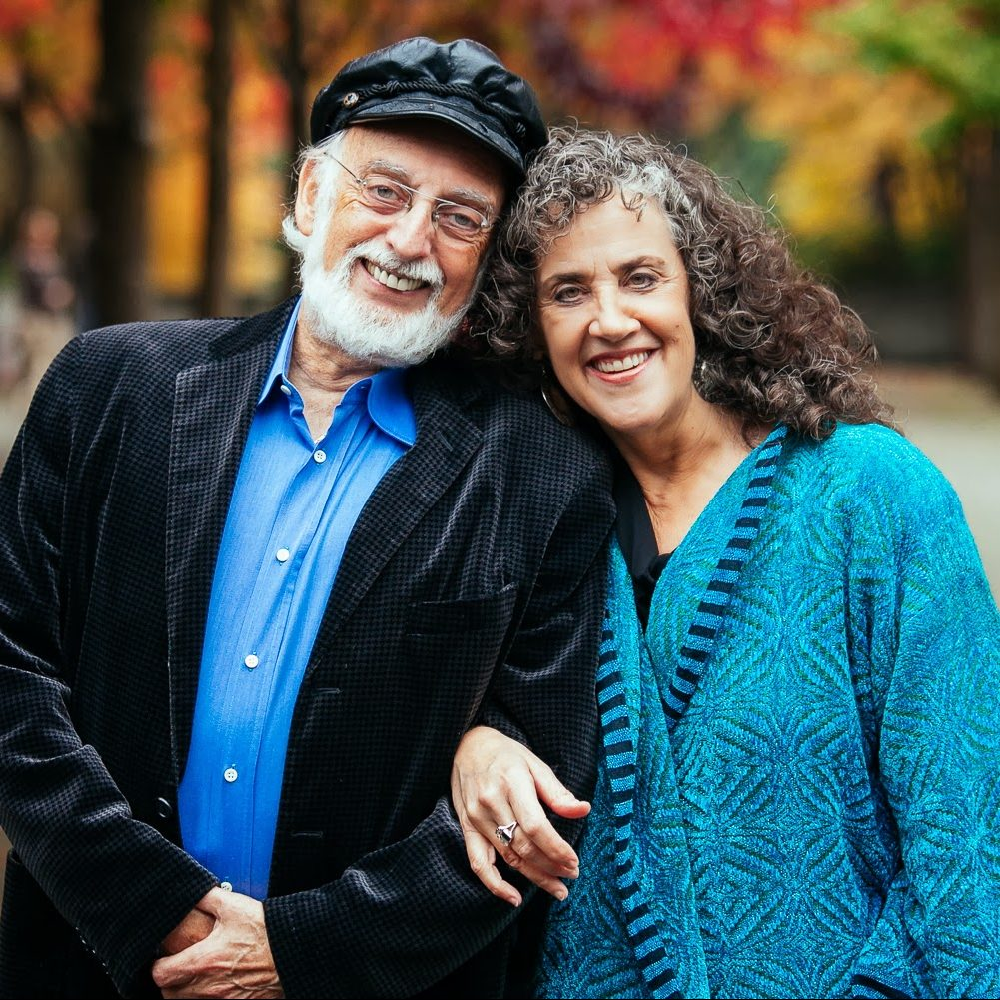
The Magic 6 Hours
Dr. John Gottman

Slide 6
Gottman’s Magic Six Hours:
1. Partings | 2 min/day = 10 min/week
2. Reunions | 20 min/day = 1 hr 40 min/week
3. Admiration and Appreciation | 5 min/day = 35 min/week
4. Affection | 5 min/day = 35 min/week
5. Weekly Date | 2 hr/week
6. State of the Union Meeting | 1 hr/week
Notes:
See gottman.com

Slide 7

Couple Conversation
Magic 6 Hours
Notes:
[Play soft music during this time]
ASK: Does anyone have any thoughts on the Magic 6 Hours they want to share?

Slide 8
Magic 6 Hours
How can we make time each week for the “Magic 6 Hours”?
How can we make partings and reunions more special?
What does a “stress-reducing conversation” look like to me?
Do I like to talk about work/school right when I get home? Wait until later?
What are some ways I could best show love, appreciation and affection to you?
What are some dates we’ve been on in the past that you’d like to repeat?
What are some new date ideas we’d like to try?
How do we feel about the idea of a “State of the Union” meeting?
What do we think about starting that now, before we get married?

Slide 9
Learning
{"A?":"B","a":5,"d":"B","h":"www.canva.com","c":"DAEgbdBprh8","i":"FnFG1mVckmNm2nHbe8Jk-w","b":1626545686976,"A":[{"A?":"H","A":577.6594676811845,"B":869.7560883241679,"D":158.8290593032107,"C":152.07900524417002,"b":179.66692039007123,"a":172.03128097638478,"c":[{"A?":"I","A":1.4210854715202004e-14,"B":-1.4210854715202004e-14,"D":179.66692039007128,"C":172.03128097638475,"a":{"A":false,"C":"#cced00"}},{"A?":"I","A":35.67732265908816,"B":39.4951423659314,"D":100.67663565820844,"C":100.67663565820844,"N":"illustration","a":{"A":false,"B":{"A":{"A":"MAB0QaOUxuU","B":2},"B":{"D":100.67663565820844,"C":100.67663565820844},"C":{"#010101":"#1b1a1a"}}}}]}],"B":1920,"C":1080}

Slide 10
When properly done, seeking help from others does not break the loyalty you have built.

Slide 11

Seeking Outside Help
Marital Support System
Other Resources

Slide 12
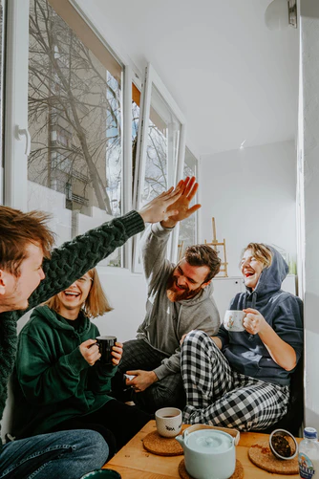

Marital Support
System
Notes:
www.freepik.com

Slide 13

Other
Resources
Notes:
www.freepik.com

Slide 14

Resources
{"A?":"B","a":5,"d":"B","h":"www.canva.com","c":"DAEgbdBprh8","i":"FnFG1mVckmNm2nHbe8Jk-w","b":1626545686976,"A":[{"A?":"H","A":577.6594676811845,"B":869.7560883241679,"D":158.8290593032107,"C":152.07900524417002,"b":179.66692039007123,"a":172.03128097638478,"c":[{"A?":"I","A":1.4210854715202004e-14,"B":-1.4210854715202004e-14,"D":179.66692039007128,"C":172.03128097638475,"a":{"A":false,"C":"#cced00"}},{"A?":"I","A":35.67732265908816,"B":39.4951423659314,"D":100.67663565820844,"C":100.67663565820844,"N":"illustration","a":{"A":false,"B":{"A":{"A":"MAB0QaOUxuU","B":2},"B":{"D":100.67663565820844,"C":100.67663565820844},"C":{"#010101":"#1b1a1a"}}}}]}],"B":1920,"C":1080}
Notes:
www.freepik.com

Slide 15
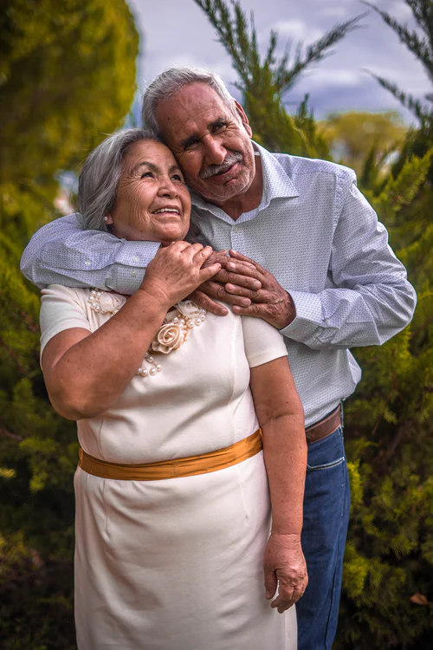
Couple Conversation
Marital Support System
Notes:
[Play soft music during this time]

Slide 16
Marital Support System
What are some ground rules about how we will talk to others about our marriage?
Who are some people that we could include in our “go-to” marriage-support system?

Slide 17
Serving
{"A?":"B","a":5,"d":"B","h":"www.canva.com","c":"DAEgbdBprh8","i":"FnFG1mVckmNm2nHbe8Jk-w","b":1626545686976,"A":[{"A?":"H","A":577.6594676811845,"B":869.7560883241679,"D":158.8290593032107,"C":152.07900524417002,"b":179.66692039007123,"a":172.03128097638478,"c":[{"A?":"I","A":1.4210854715202004e-14,"B":-1.4210854715202004e-14,"D":179.66692039007128,"C":172.03128097638475,"a":{"A":false,"C":"#cced00"}},{"A?":"I","A":35.67732265908816,"B":39.4951423659314,"D":100.67663565820844,"C":100.67663565820844,"N":"illustration","a":{"A":false,"B":{"A":{"A":"MAB0QaOUxuU","B":2},"B":{"D":100.67663565820844,"C":100.67663565820844},"C":{"#010101":"#1b1a1a"}}}}]}],"B":1920,"C":1080}

Slide 18
“For whosoever will save his life shall lose it; and whosoever shall lose his life for my sake shall find it.”
Matthew 16:25

Slide 19
Couple generativity increases couple identity and strength.

Slide 20
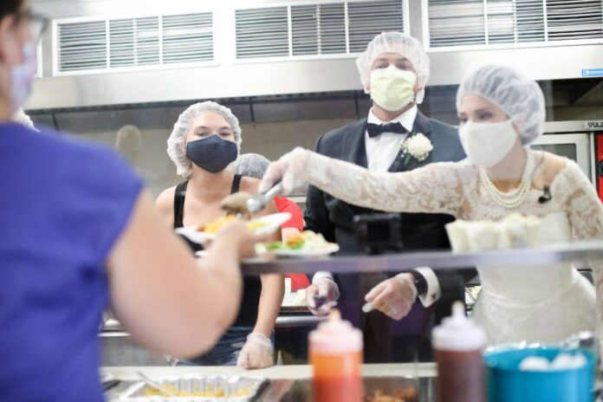
goodnewsnetwork.org, 4 Sep 2020, credit Caroline Stoltzfus/The City Mission

Slide 21
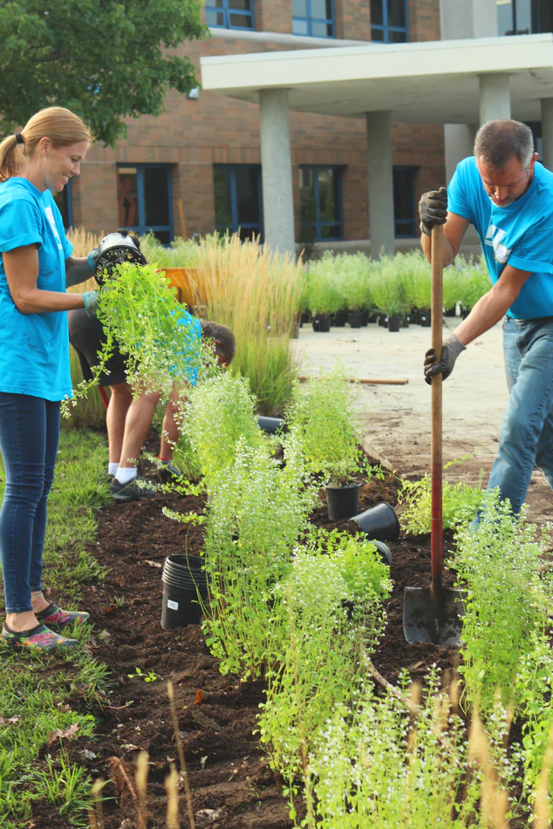
Couple Conversation
Serving
Notes:
[Play soft music during this time]

Slide 22
Serving
What are some causes we might join to make a difference? What are things we especially care about protecting, supporting or improving in our families and community?
What are some of our personal missions/ministries? How can we support each other in our personal ministries?
Who are some people we could minister to together?
How can we answer the call of The Family Proclamation to promote measures that strengthen marriages and families?

Slide 23
Congratulations!
{"A?":"B","a":5,"d":"B","h":"www.canva.com","c":"DAEgbdBprh8","i":"FnFG1mVckmNm2nHbe8Jk-w","b":1626545686976,"A":[{"A?":"H","A":577.6594676811845,"B":869.7560883241679,"D":158.8290593032107,"C":152.07900524417002,"b":179.66692039007123,"a":172.03128097638478,"c":[{"A?":"I","A":1.4210854715202004e-14,"B":-1.4210854715202004e-14,"D":179.66692039007128,"C":172.03128097638475,"a":{"A":false,"C":"#cced00"}},{"A?":"I","A":35.67732265908816,"B":39.4951423659314,"D":100.67663565820844,"C":100.67663565820844,"N":"illustration","a":{"A":false,"B":{"A":{"A":"MAB0QaOUxuU","B":2},"B":{"D":100.67663565820844,"C":100.67663565820844},"C":{"#010101":"#1b1a1a"}}}}]}],"B":1920,"C":1080}

Slide 24
For each of you, what has been your “take-away” from Anxiously Engaged?
Please type it into the chat.

Slide 25
“Whatever Jesus lays his hands upon lives. If Jesus lays his hands upon a marriage, it lives.”
- President Howard W. Hunter

Slide 26
Stay in touch!
Website: AnxiouslyEngaged.byu.edu
Instagram: @anxiously__engaged
Email: anxiously.engaged.marriage.prep@gmail.com
Notes:
www.freepik.com

Slide 27
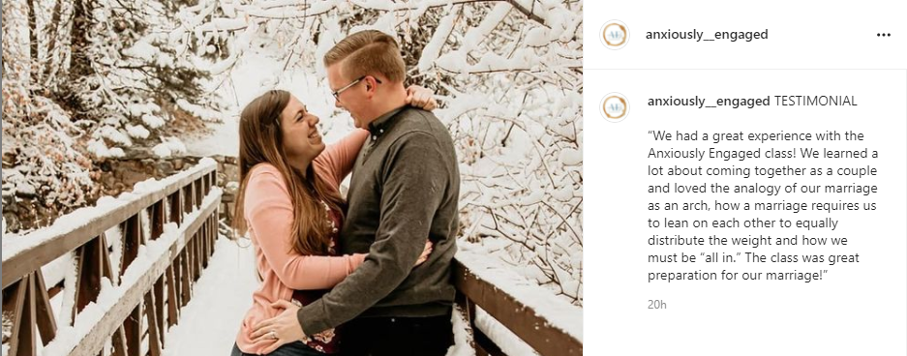
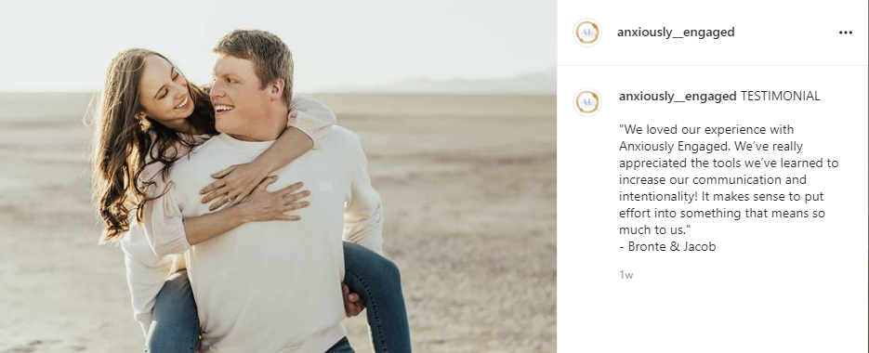
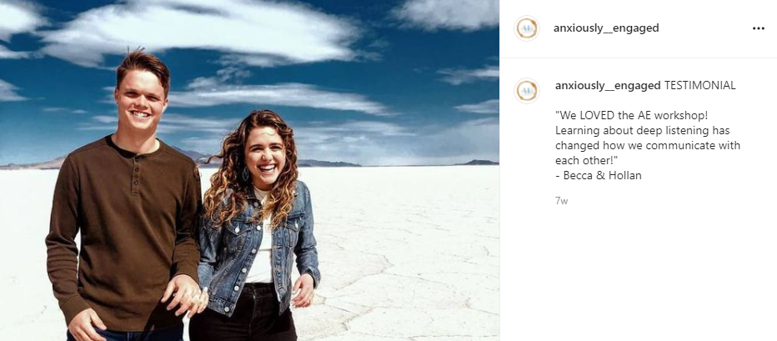
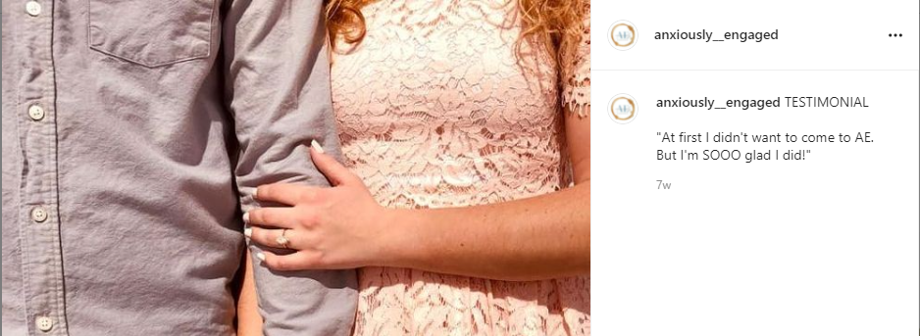
Testimonials & Referrals

Slide 28
Marriage License
Discount Reminder
{"A?":"B","a":5,"d":"B","h":"www.canva.com","c":"DAEgbdBprh8","i":"FnFG1mVckmNm2nHbe8Jk-w","b":1626545686976,"A":[{"A?":"H","A":577.6594676811845,"B":869.7560883241679,"D":158.8290593032107,"C":152.07900524417002,"b":179.66692039007123,"a":172.03128097638478,"c":[{"A?":"I","A":1.4210854715202004e-14,"B":-1.4210854715202004e-14,"D":179.66692039007128,"C":172.03128097638475,"a":{"A":false,"C":"#cced00"}},{"A?":"I","A":35.67732265908816,"B":39.4951423659314,"D":100.67663565820844,"C":100.67663565820844,"N":"illustration","a":{"A":false,"B":{"A":{"A":"MAB0QaOUxuU","B":2},"B":{"D":100.67663565820844,"C":100.67663565820844},"C":{"#010101":"#1b1a1a"}}}}]}],"B":1920,"C":1080}

Slide 29
Homework
{"A?":"B","a":5,"d":"B","h":"www.canva.com","c":"DAEgbdBprh8","i":"FnFG1mVckmNm2nHbe8Jk-w","b":1626545686976,"A":[{"A?":"H","A":577.6594676811845,"B":869.7560883241679,"D":158.8290593032107,"C":152.07900524417002,"b":179.66692039007123,"a":172.03128097638478,"c":[{"A?":"I","A":1.4210854715202004e-14,"B":-1.4210854715202004e-14,"D":179.66692039007128,"C":172.03128097638475,"a":{"A":false,"C":"#cced00"}},{"A?":"I","A":35.67732265908816,"B":39.4951423659314,"D":100.67663565820844,"C":100.67663565820844,"N":"illustration","a":{"A":false,"B":{"A":{"A":"MAB0QaOUxuU","B":2},"B":{"D":100.67663565820844,"C":100.67663565820844},"C":{"#010101":"#1b1a1a"}}}}]}],"B":1920,"C":1080}
Decide on the next step of your “marriage program”
Listen to a podcast?
Read a book?
Do a supplemental lesson?
Notes:
www.freepik.com

